Slide 1

46th Annual Meeting
Montréal, Québec, Canada
Photos

Slide 2
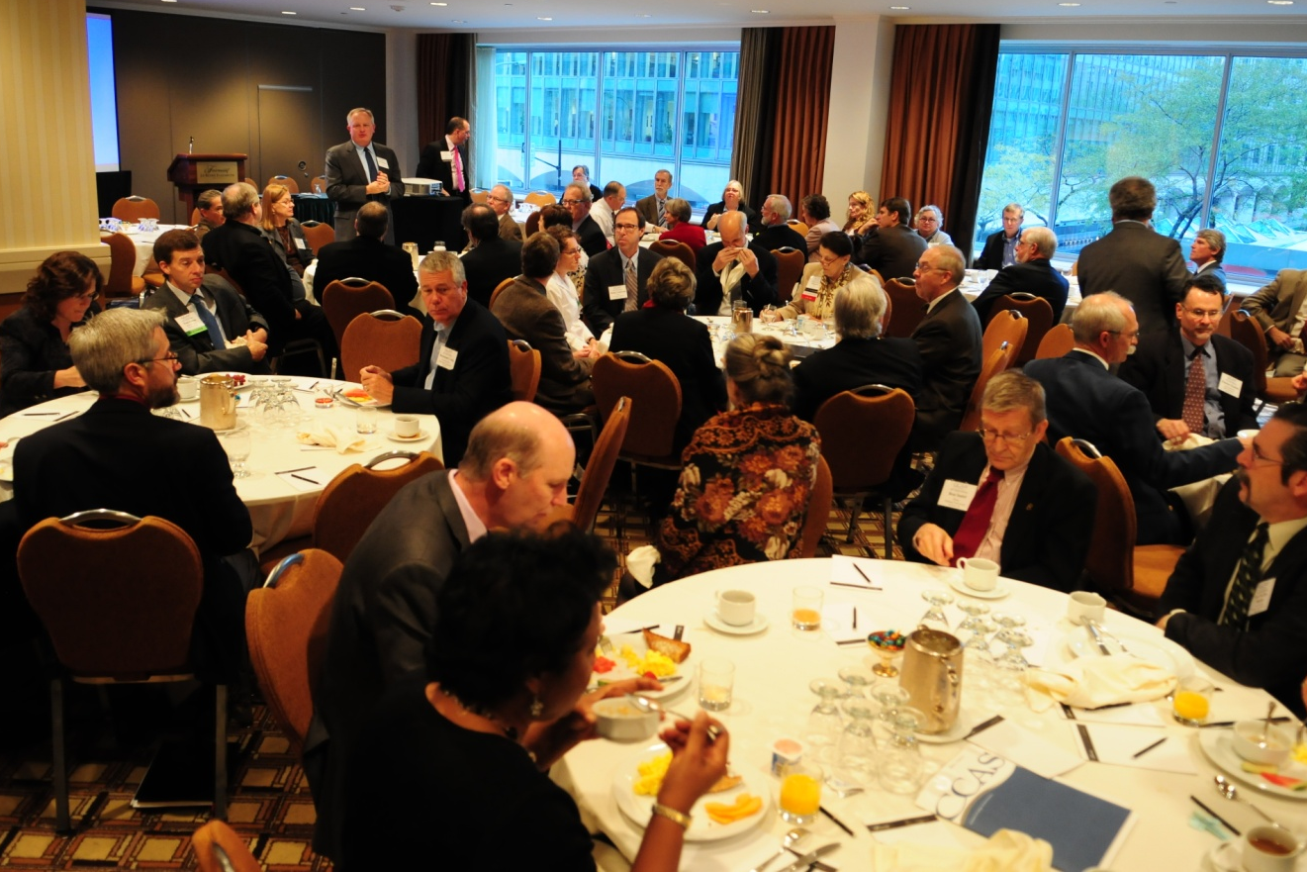
Thursday’s Breakfast for Research Institutions was a big draw. Chris McCord (Northern Illinois U) chaired this sector’s standing committee.

Slide 3
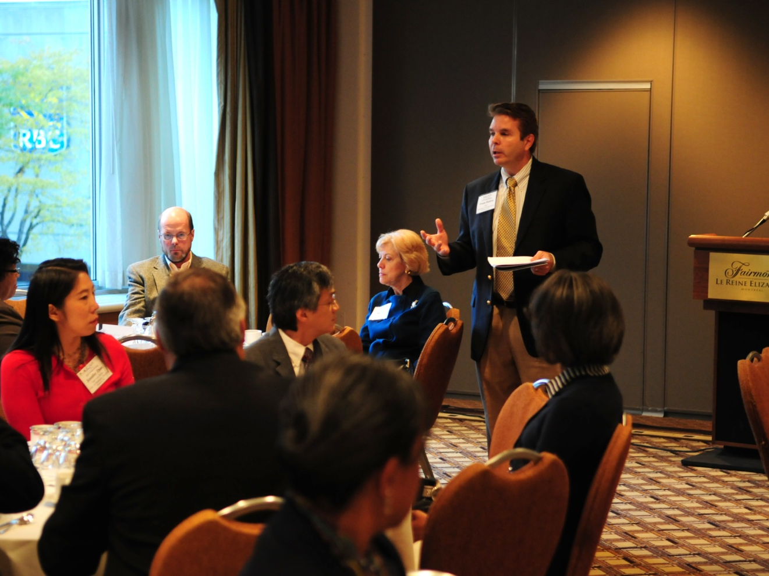
Frank Biafora (U of South Florida, St. Petersburg) facilitates the Breakfast by Sector for Metropolitan/ Urban Institutions

Slide 4
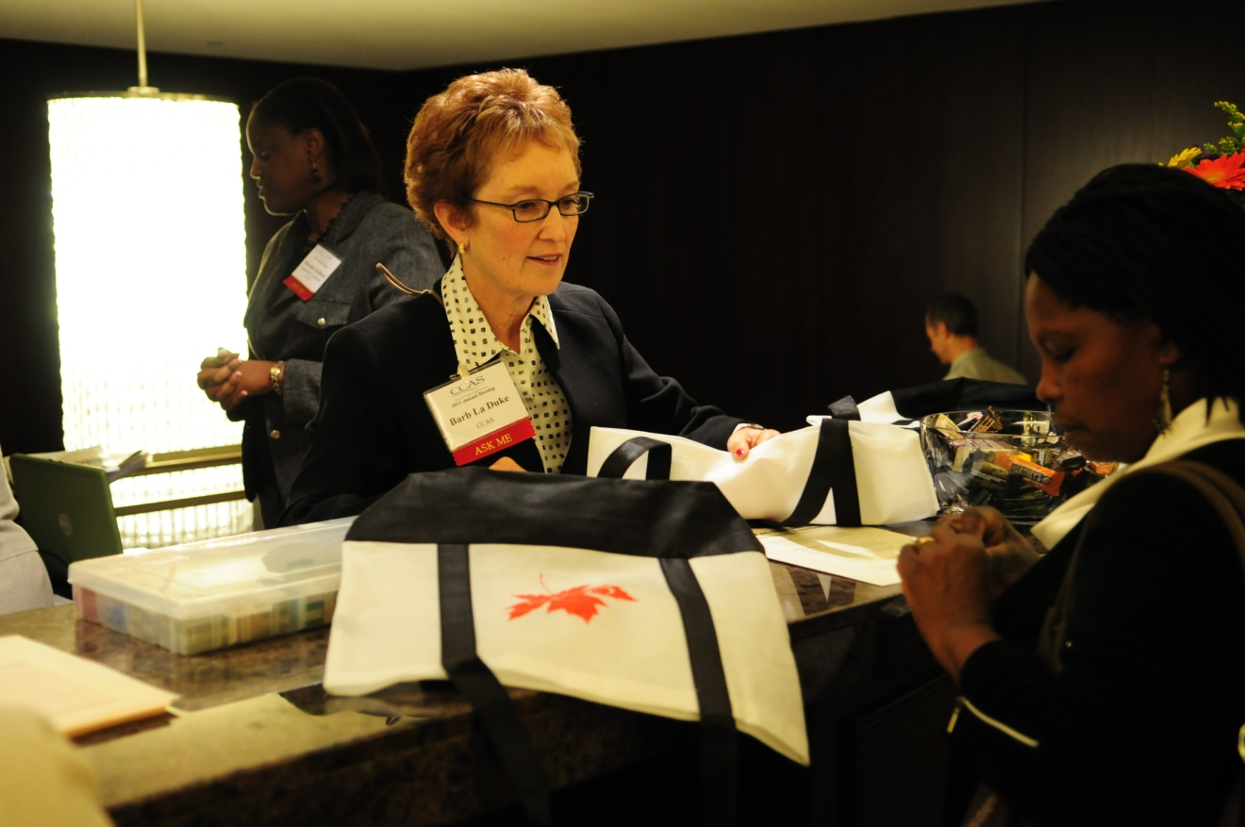
Barb La Duke registers Wamucii Njogu (Northeastern Illinois U) for the meeting.

Slide 5
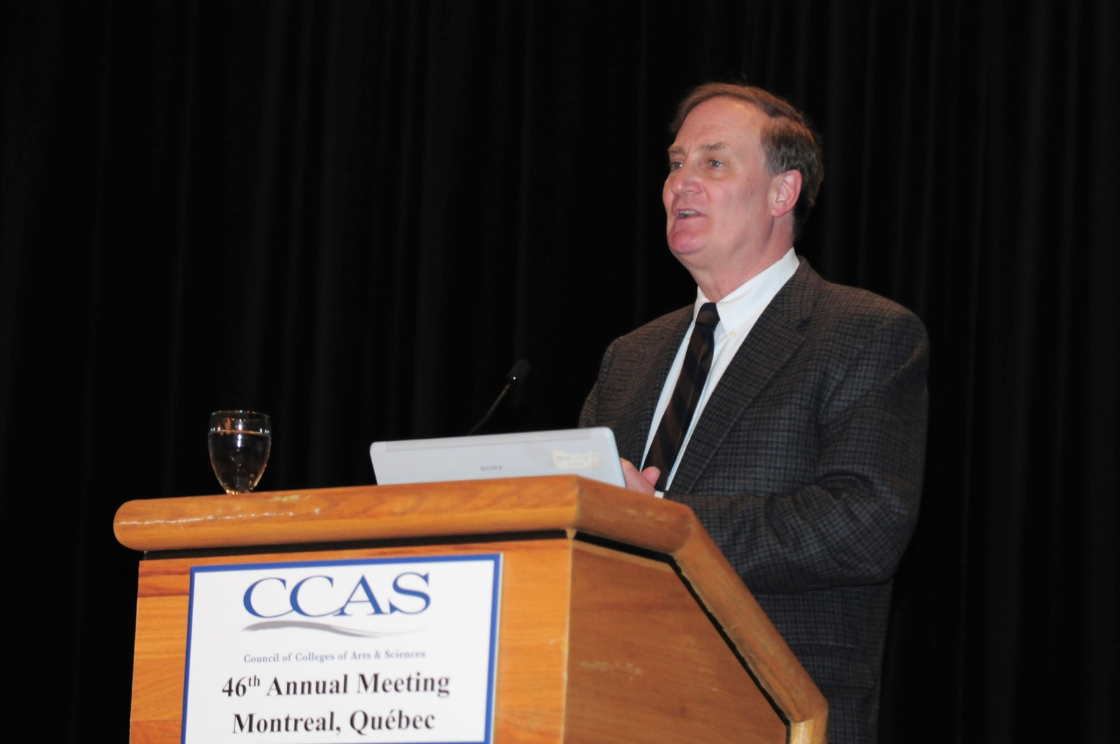
Thursday’s Keynote Speaker, Dr. Terry Hartle, ACE
Dr. Hartle’s presentation, “A View from the Hill,” is available elsewhere on this website.

Slide 6
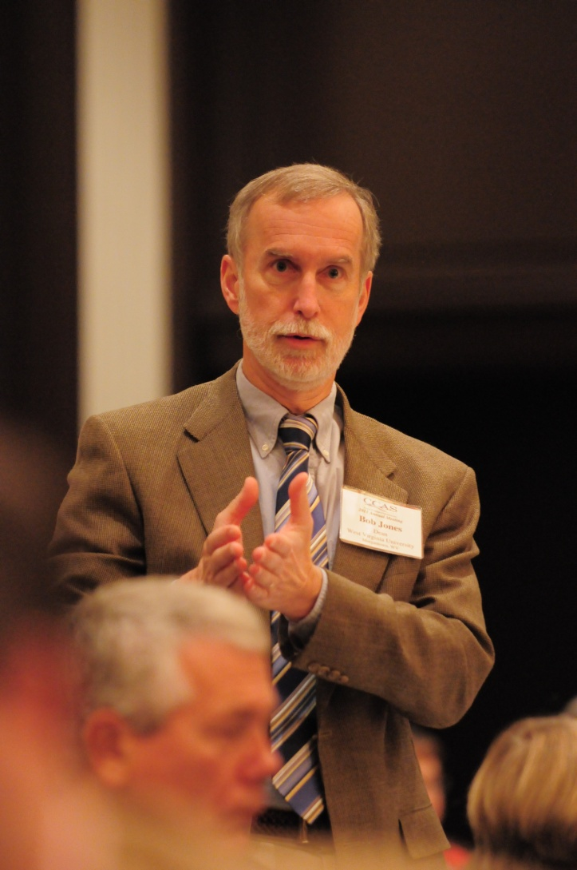
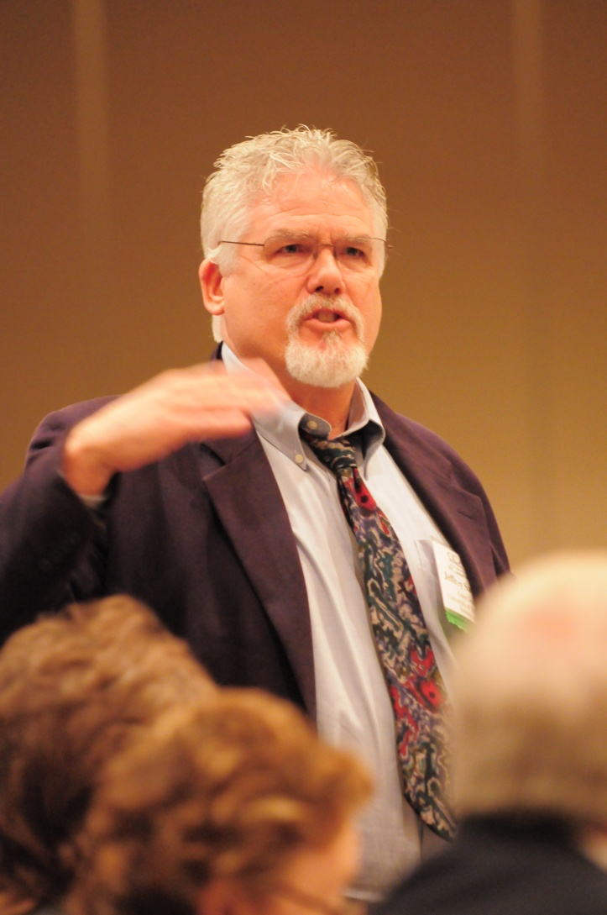
Bob Jones (West Virginia U) and Jeffrey Sawyer (U of Baltimore) respond to Terry Hartle’s remarks.

Slide 7
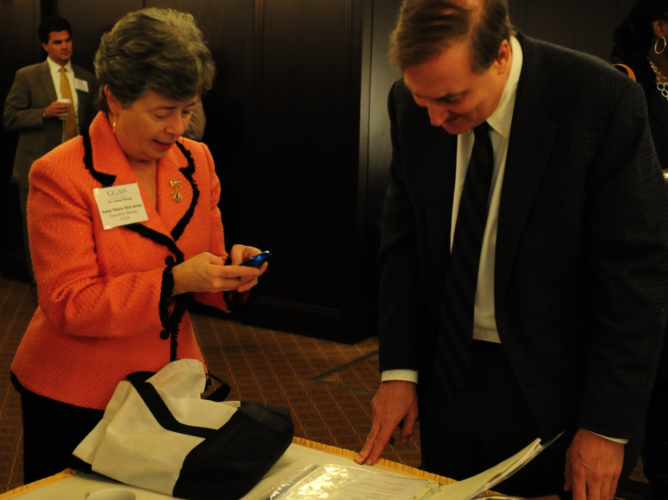
CCAS Executive Director Anne-Marie McCartan attempts to assist Terry Hartle with his return trip to the Montréal airport.

Slide 8
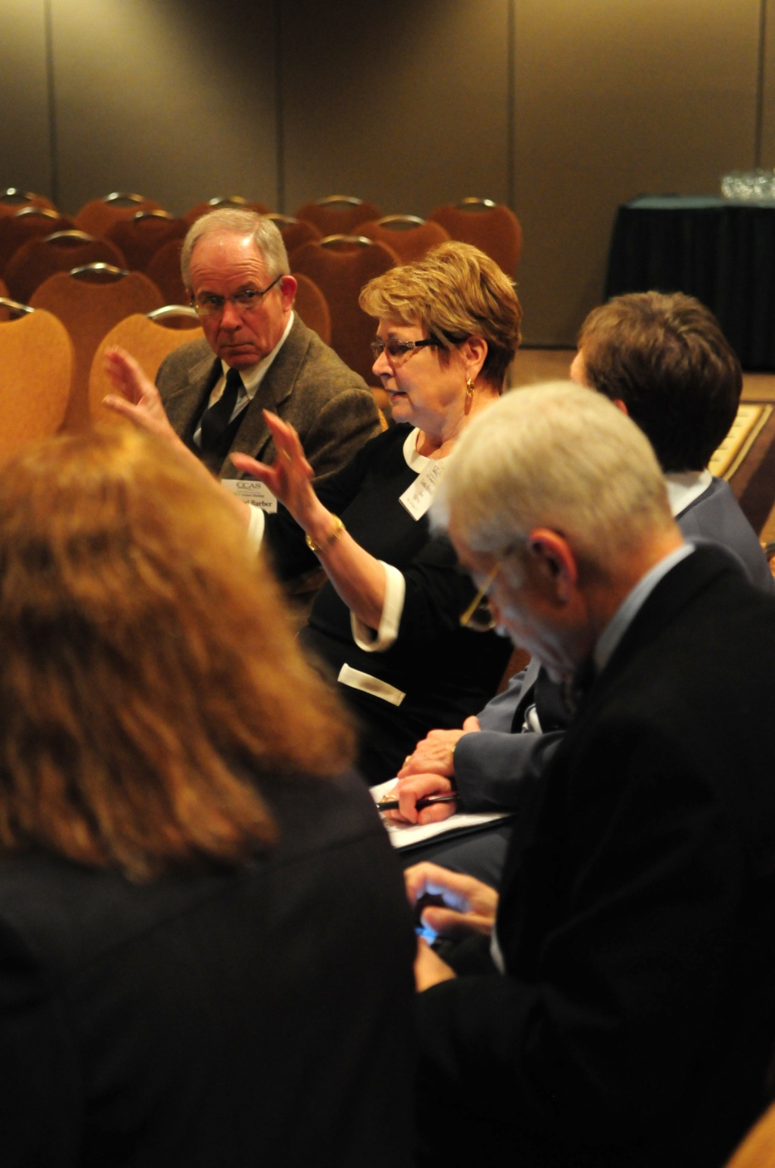
Linda Halisky (California Polytechnic State U) participated in the session “Bridges to Somewhere: Looking across the college divide.”

Slide 9
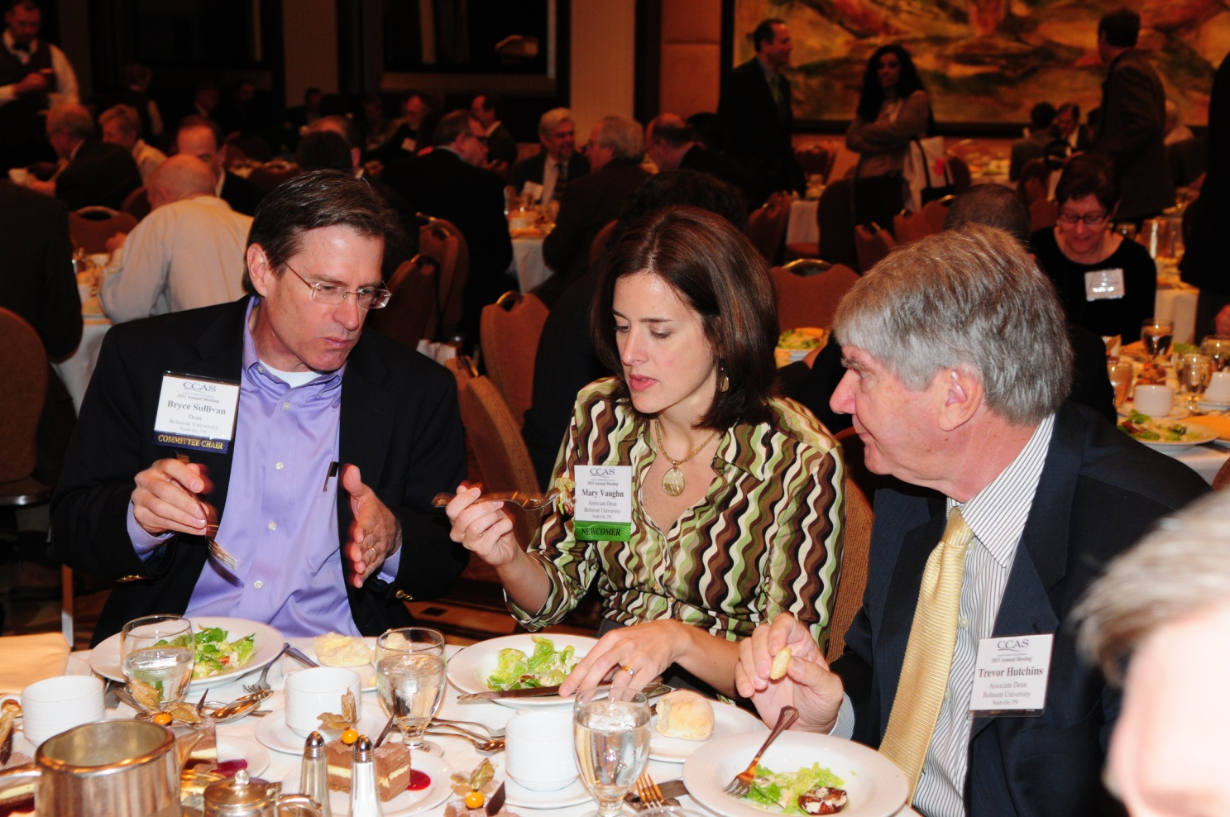
Deans from Belmont U (Bryce Sullivan, Mary Vaughn, Trevor Hutchins) debrief over lunch.

Slide 10
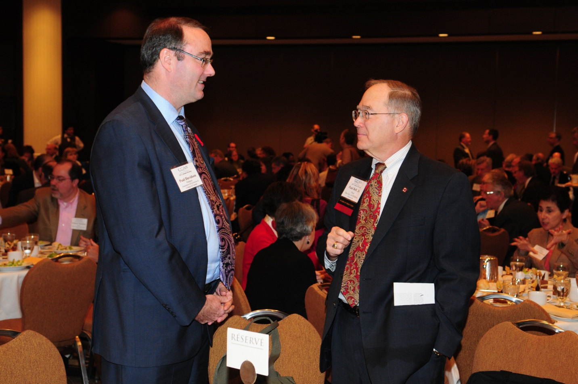
Paul Bell (U of Oklahoma, on right), chats with luncheon speaker Paul Davidson.

Slide 11
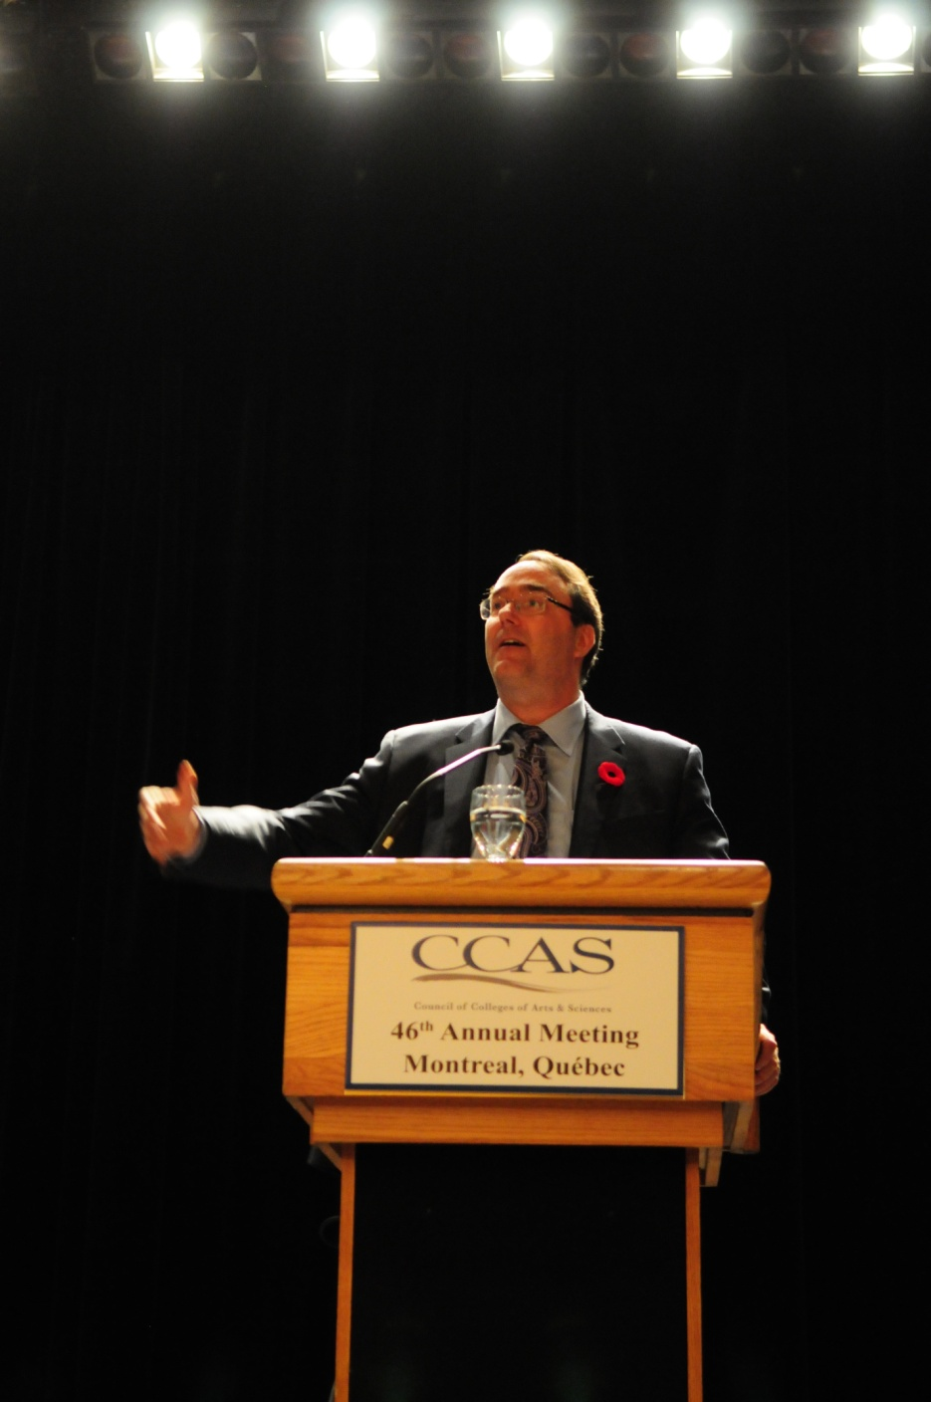
Paul Davidson, president of the Association of Universities and Colleges of Canada, spoke on “The Value of the Arts and Sciences in a Globalizing World.”
The full text of Mr. Davidson’s remarks is available elsewhere on this website.

Slide 12
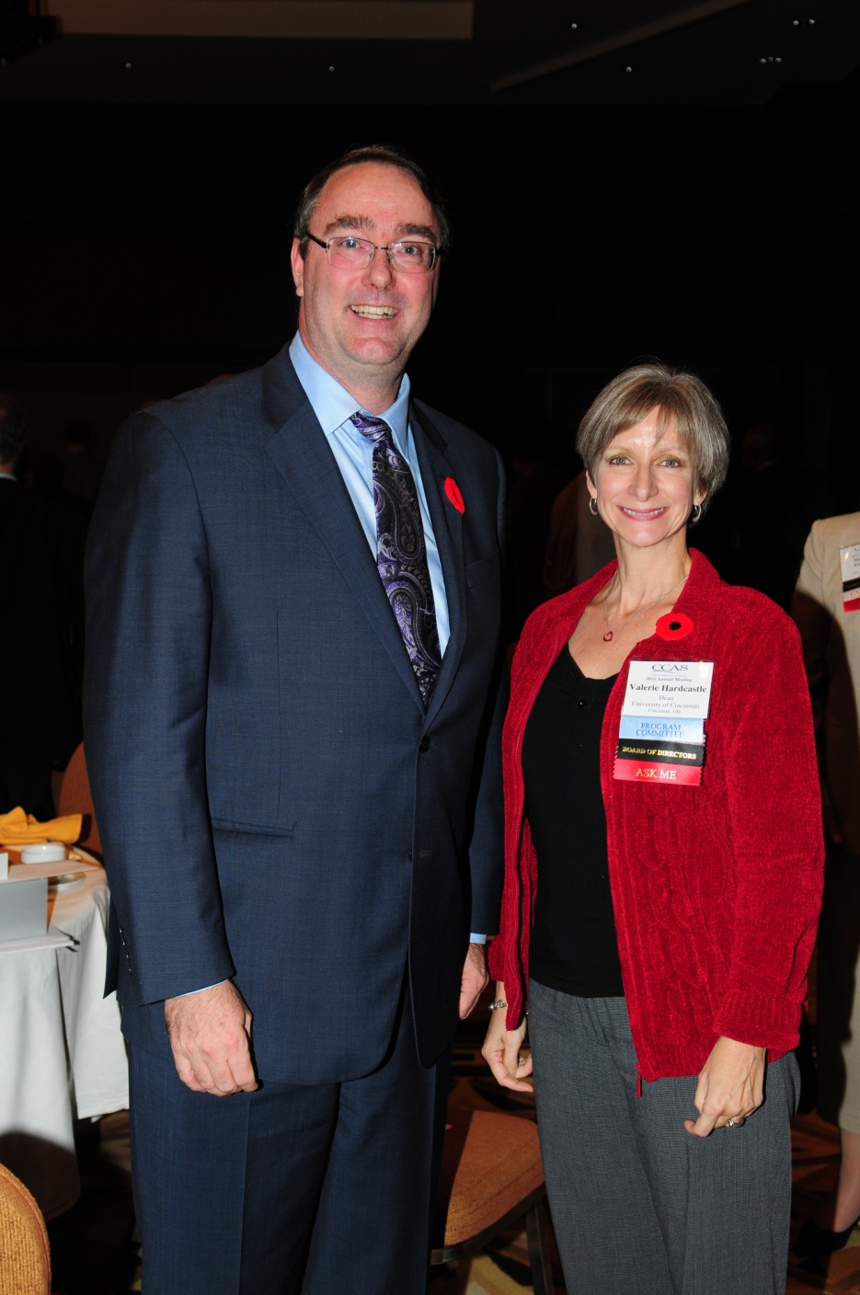
Valerie Gray Hardcastle (U of Cincinnati and incoming CCAS president) is shown with Paul Davidson of AUCC.

Slide 13
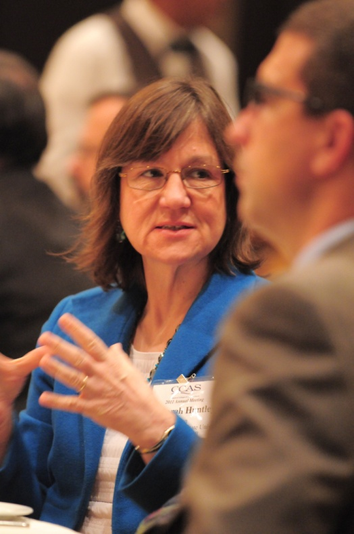
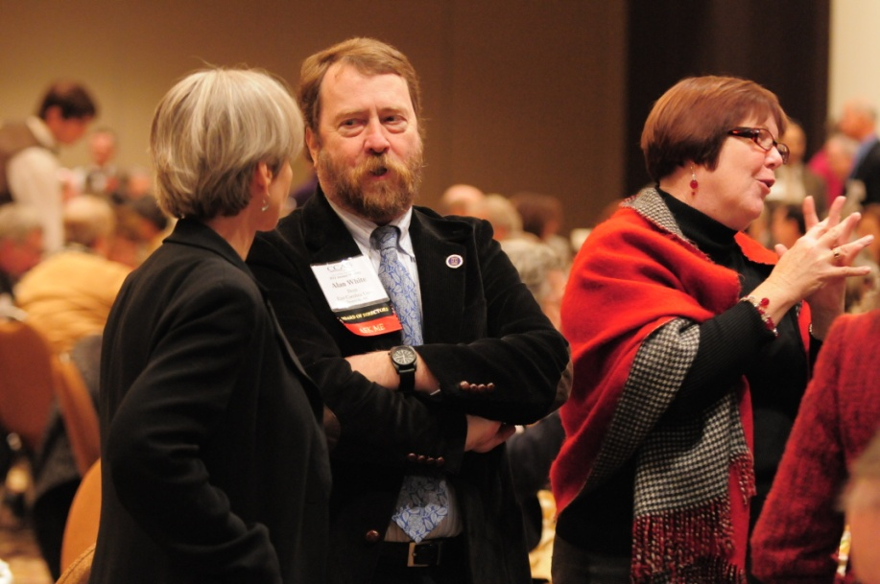
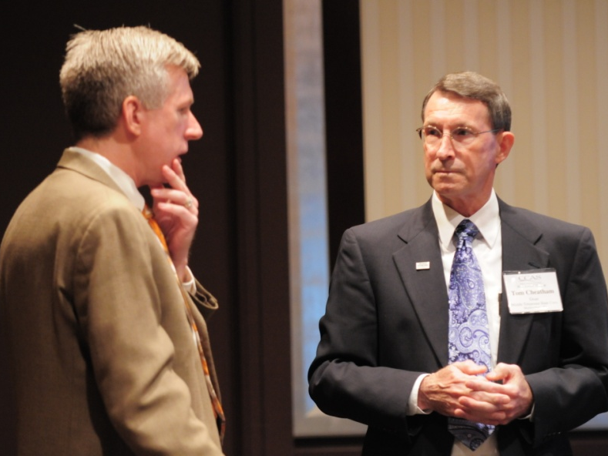
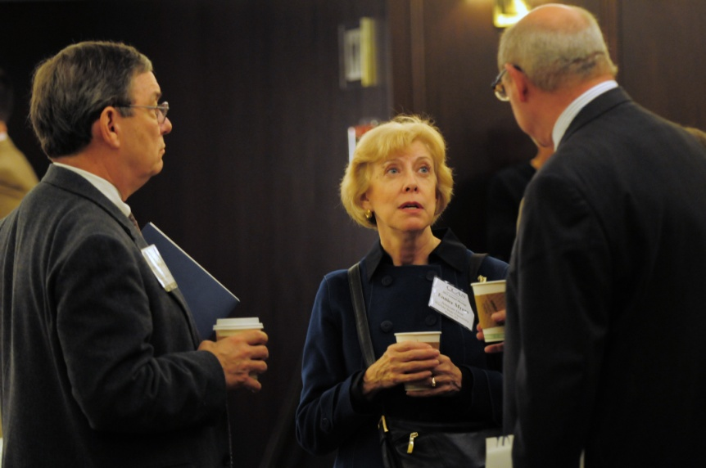
Informal networking is always an important aspect of the CCAS Annual Meeting.

Slide 14
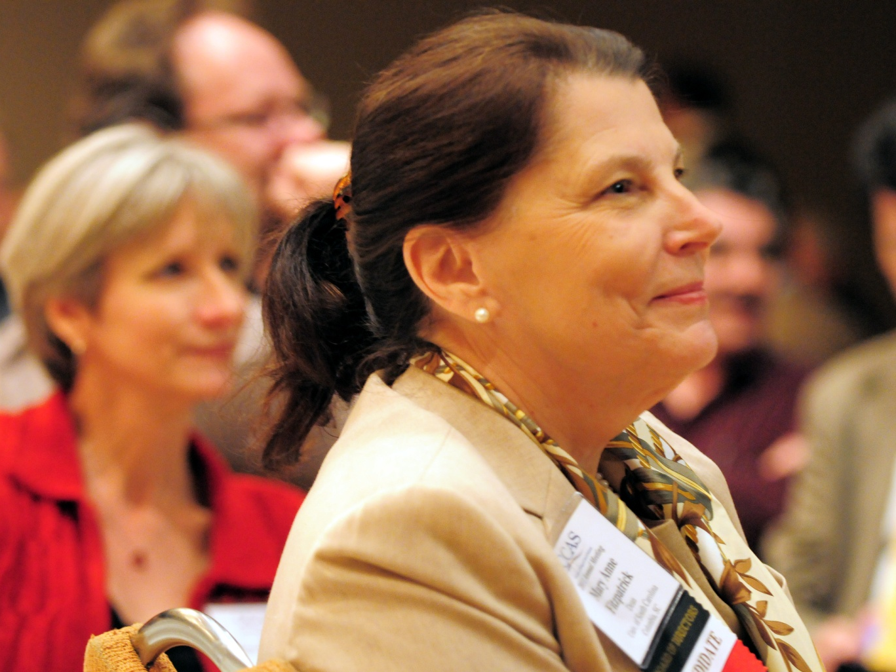
Mary Anne Fitzpatrick (U of South Carolina) was elected as CCAS president for 2012-2013.

Slide 15
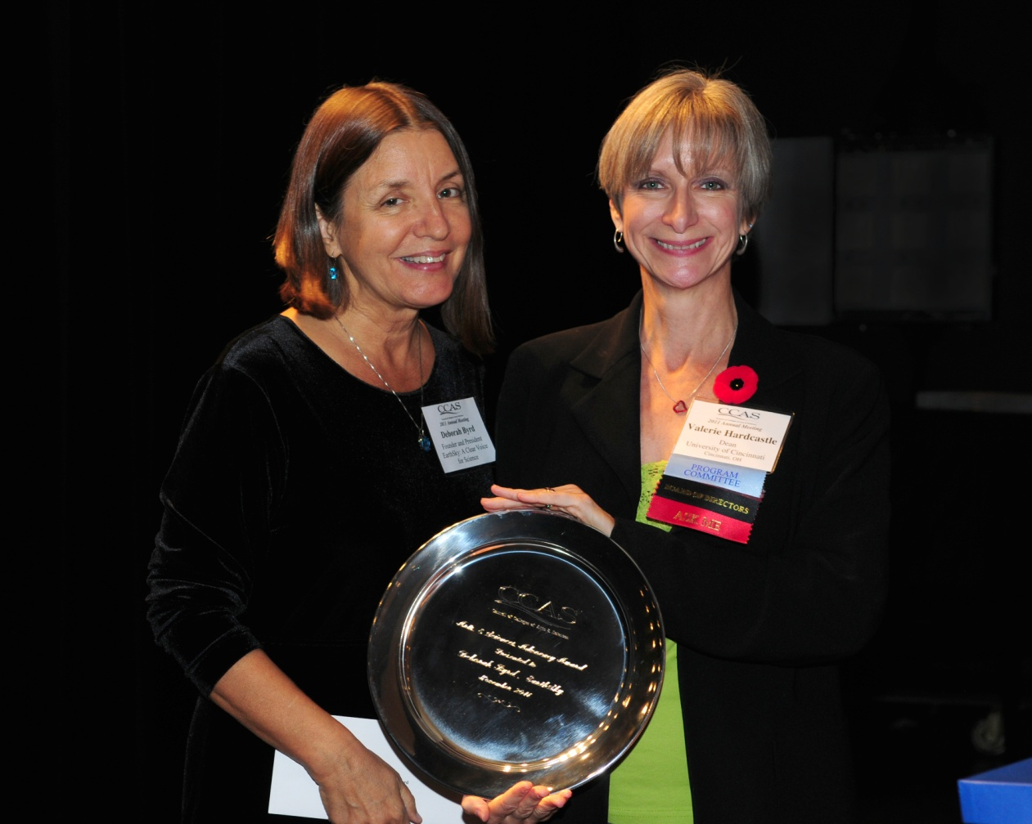
Deborah Byrd, Founder and President of EarthSky: A Clear Voice for Science, was presented with the 2011 CCAS Arts & Sciences Advocacy Award by Valerie Hardcastle, incoming CCAS president.

Slide 16
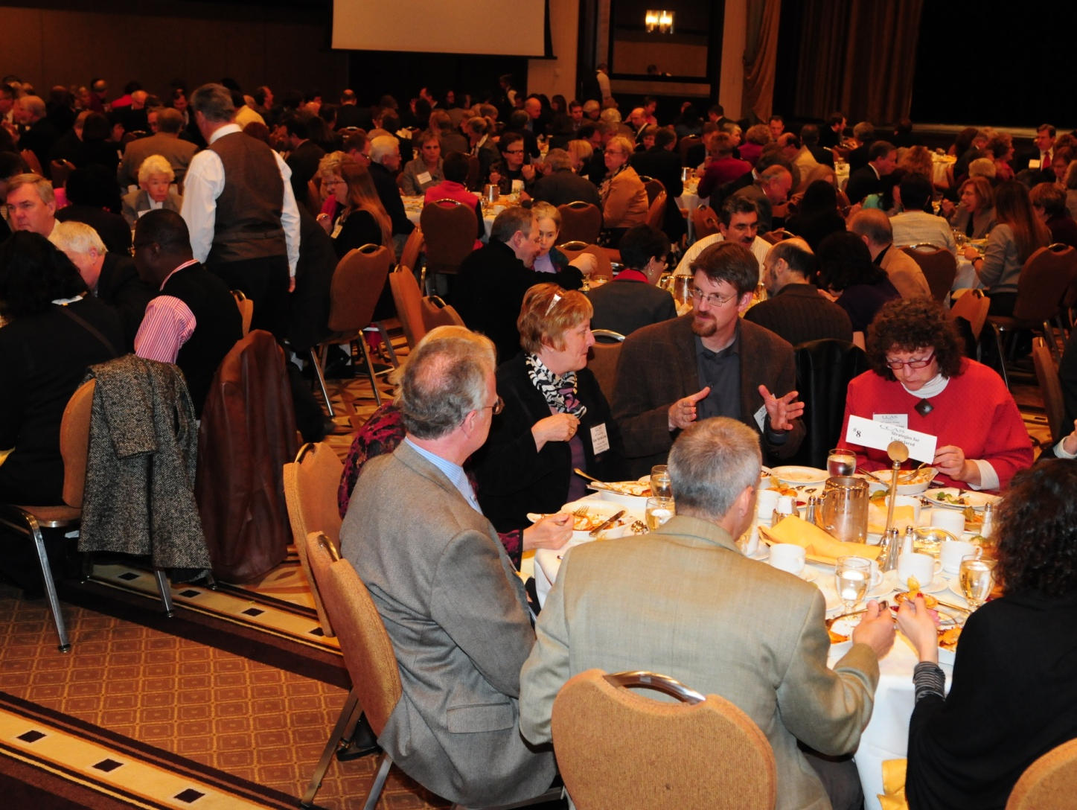
The “Special Discussion Topics for Luncheon Tables” always engender lively interchange of ideas.

Slide 17
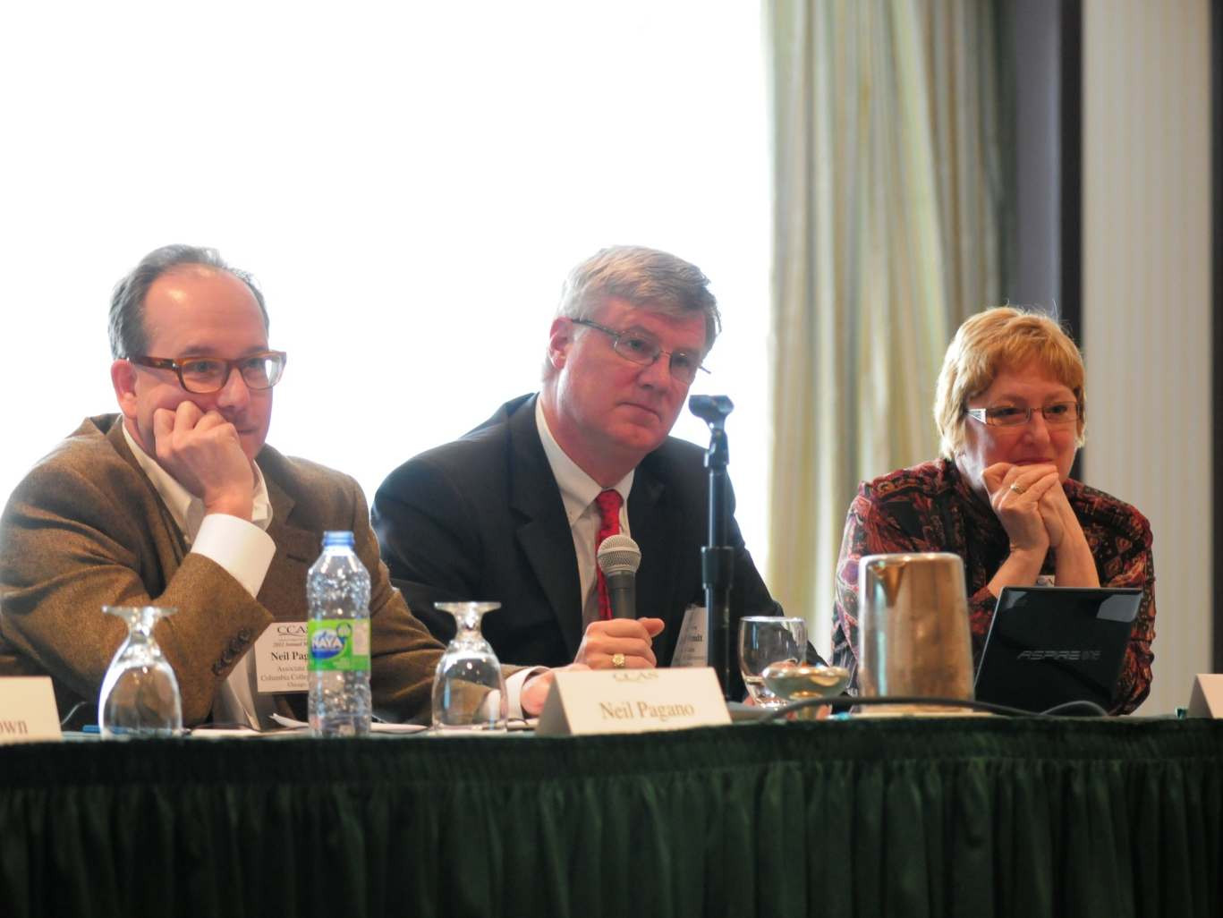
Panelists on “The Role & Impact of Regional Accreditation on Institutional Well-Being” Neil Pagano (Columbia College Chicago), Chris Arndt (James Madison U) and Kim Martin Long (Shippensburg U) take time for comments from the audience.

Slide 18
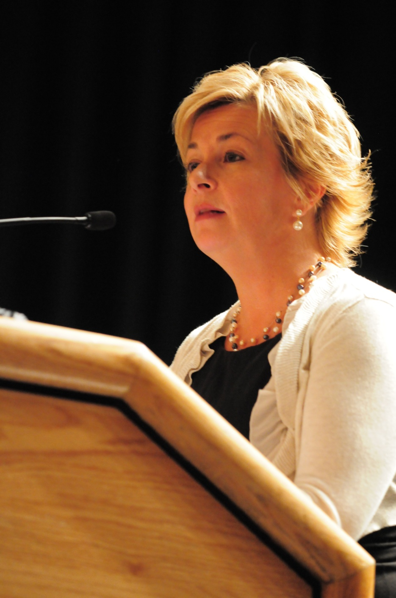
This year’s presidential address by Vickie Rutledge Shields was entitled “The Dean’s Speech: Finding our voice through intentional communication.”
Dean Shields’ remarks and video can be found elsewhere on this website.

Slide 19
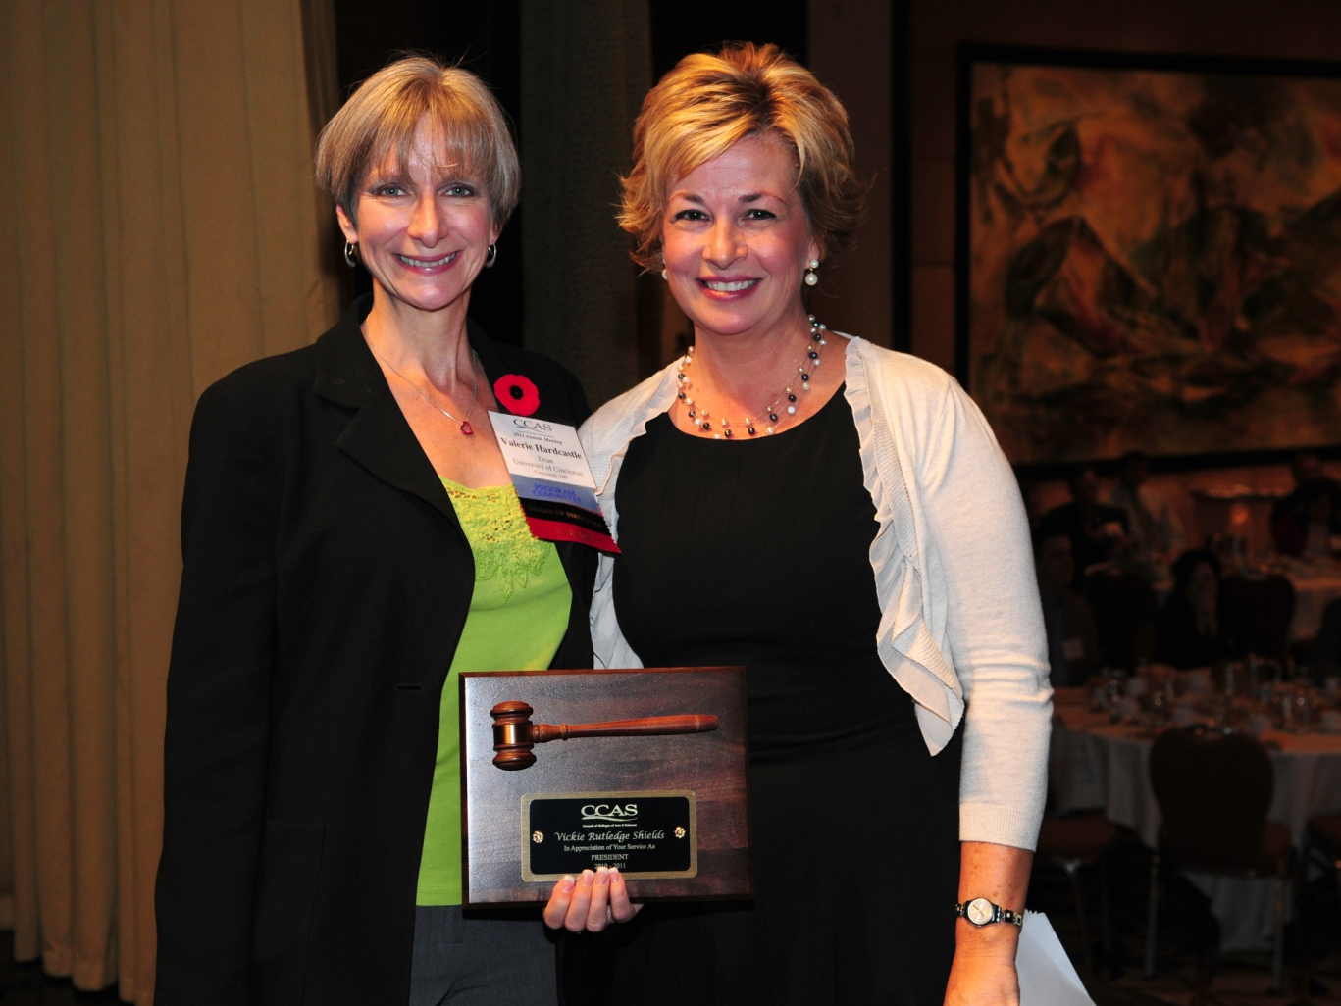
Incoming president Valerie Hardcastle presents 2010-2011 president Vickie Rutledge Shields with a presidential plaque in recognition of her service.

Slide 20
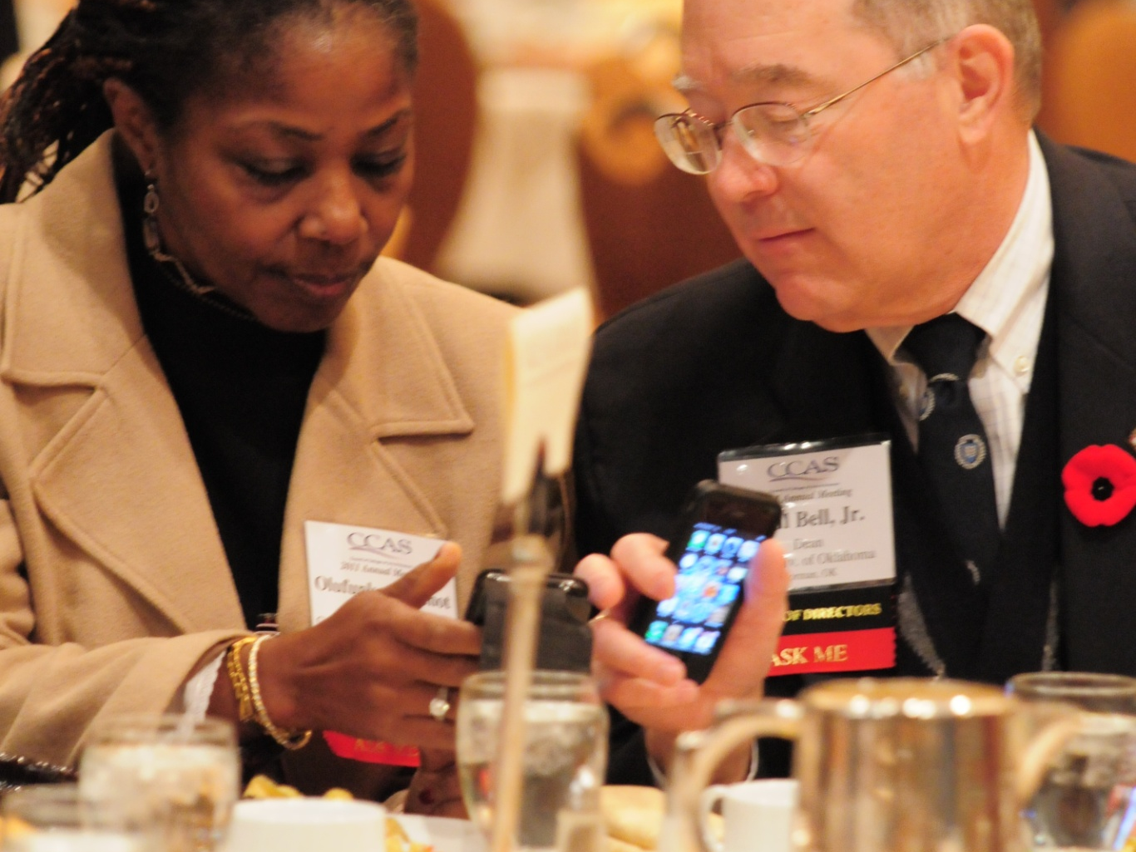
Olufunke Fontenot (Georgia College & State U) and Paul Bell (U of Oklahoma) compare educational apps.

Slide 21
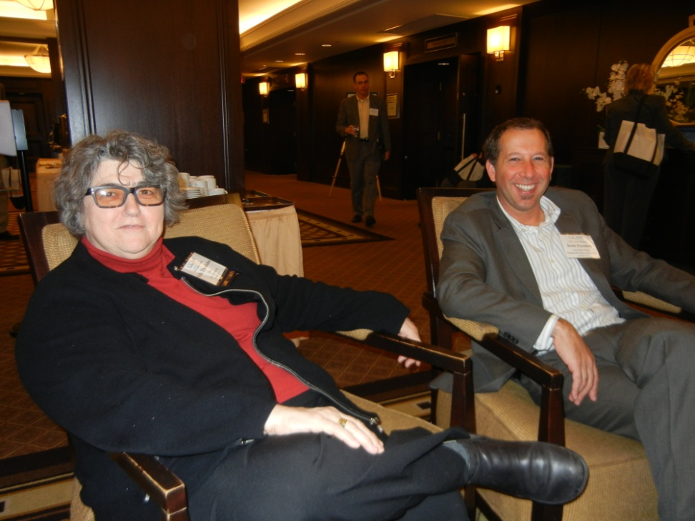
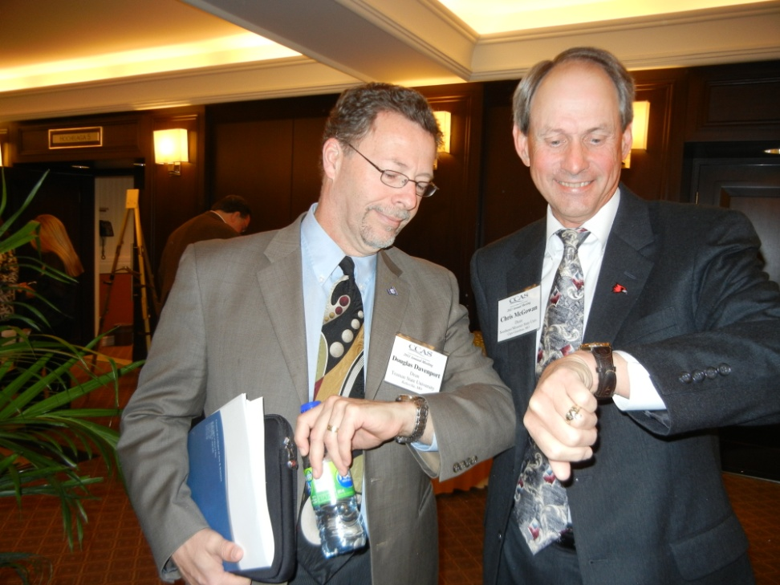
Douglas Davenport (Truman State U) and Chris McGowan (Southeast Missouri State U) check to make sure they’ll be on time for the next session.
California State University deans Stella Theodoulou (Northridge) and Scott Paynton (Humboldt) relax between sessions.

Slide 22
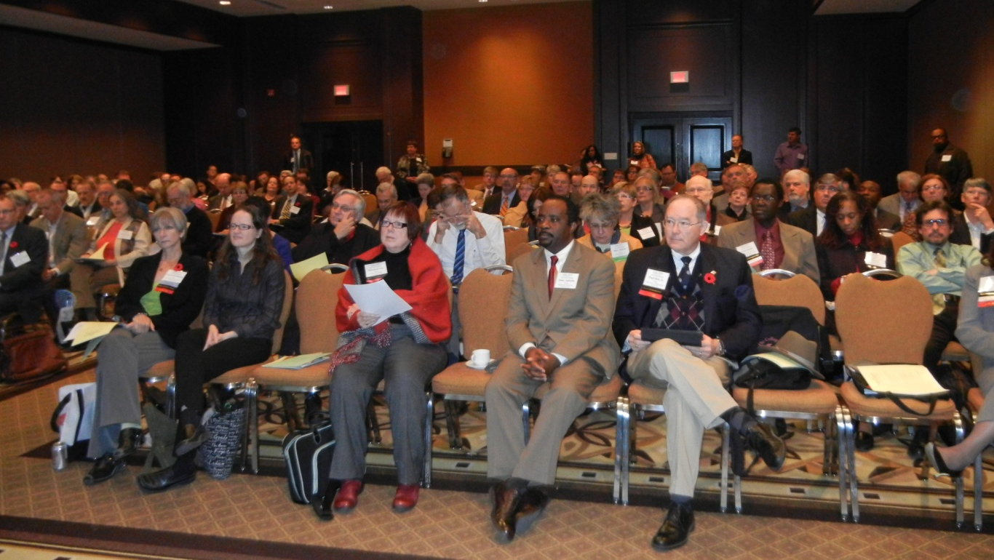
The 46th Annual Business Meeting was well attended. Three new initiatives were unveiled: Mentoring Programs for Deans; On-Campus Leadership Development Workshops for Chairs/Heads; and an online Deans Knowledge Base.

Slide 23
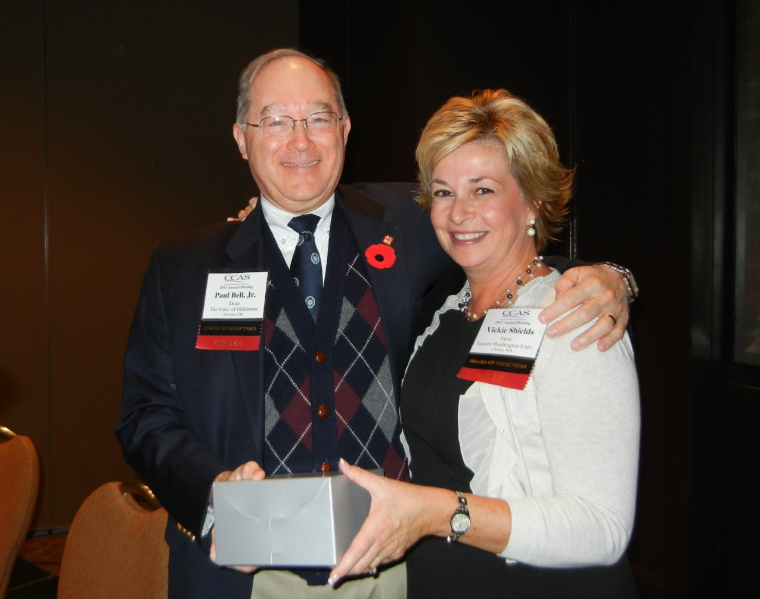
Paul B. Bell, Jr., outgoing past president, was recognized at the Business Meeting by Vickie Shields for his many contributions to CCAS over the years.

Slide 24
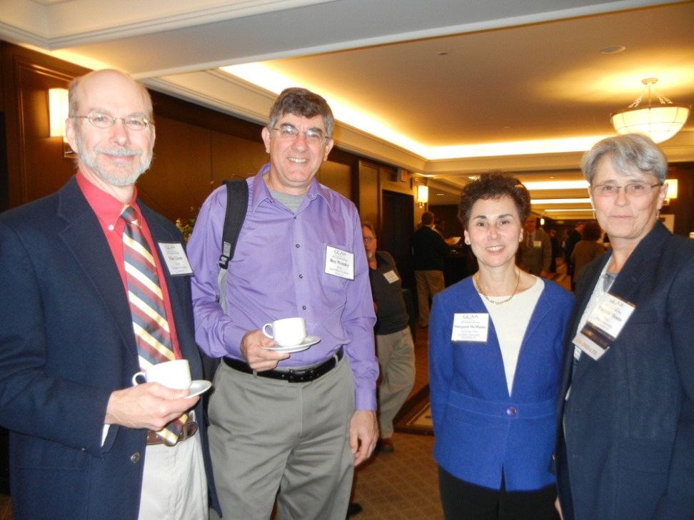
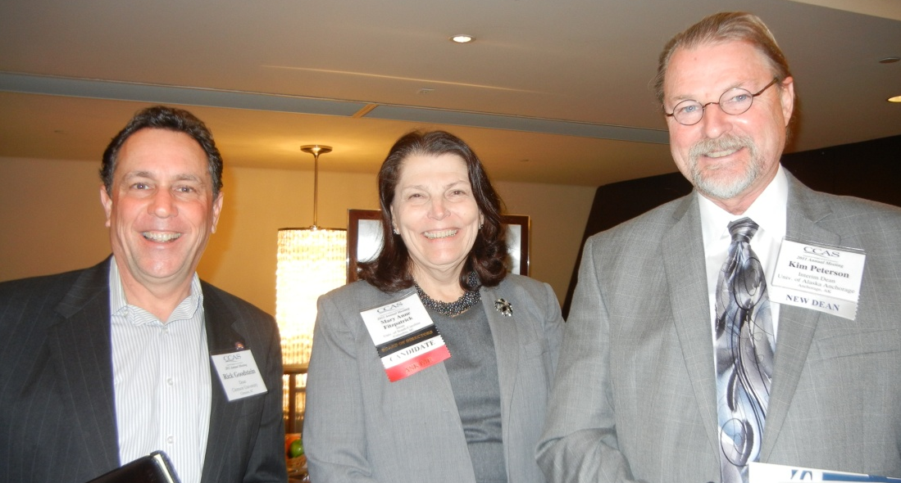
Mac Given (Neumann U), Roy Wensley (Saint Mary’s College), Peg McManus (LaSalle U), and Pat Mosto (Rider U).
Rick Goodstein (Clemson U), Mary Anne Fitzpatrick (U of South Carolina), and Kim Peterson (U of Alaska Anchorage).

Slide 25
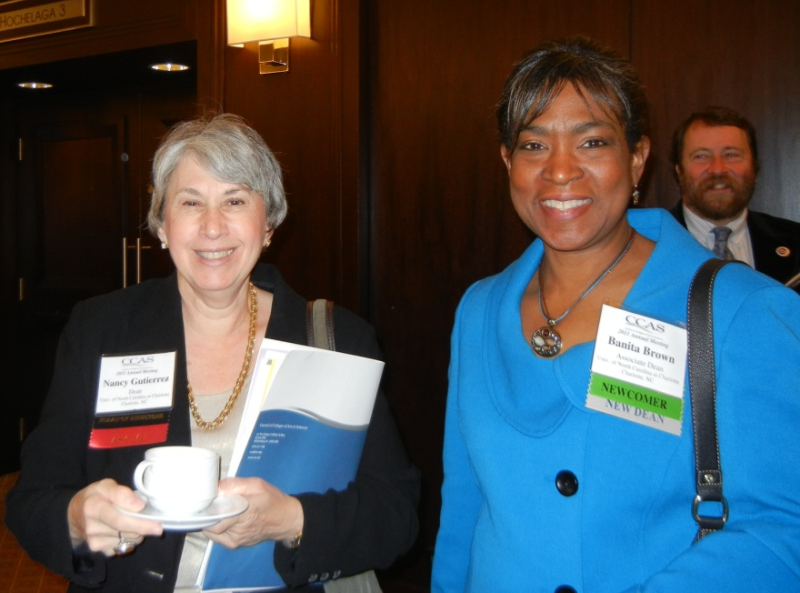
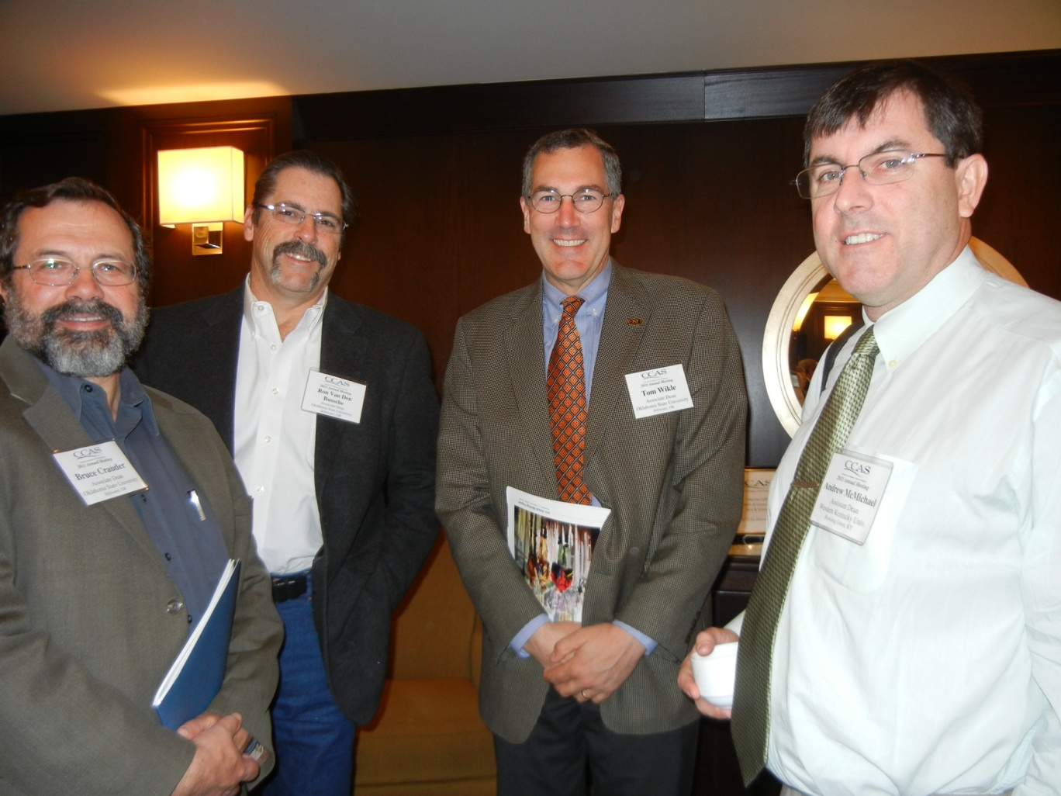
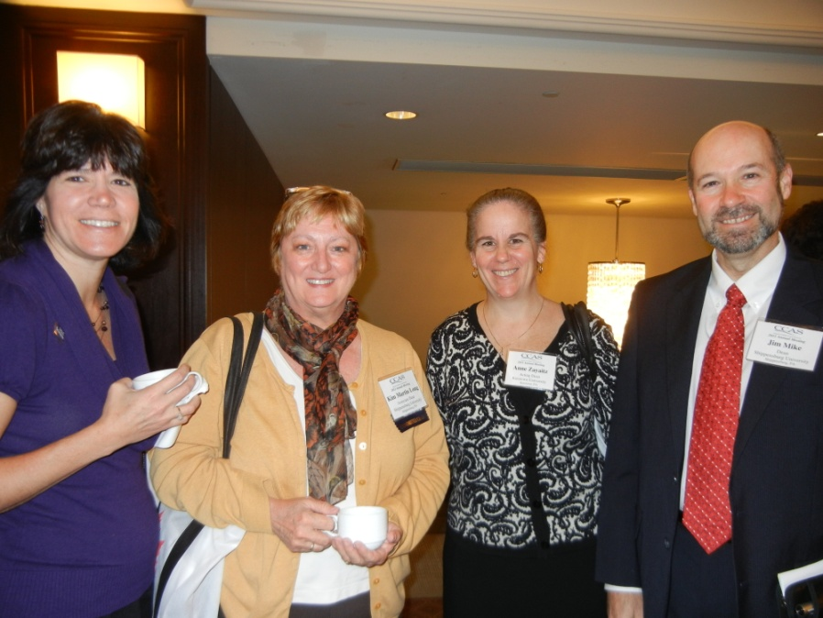
Top left: North Carolina Deans
Bottom left: Pennsylvania Deans
Above: Oklahoma State U Deans

Slide 26
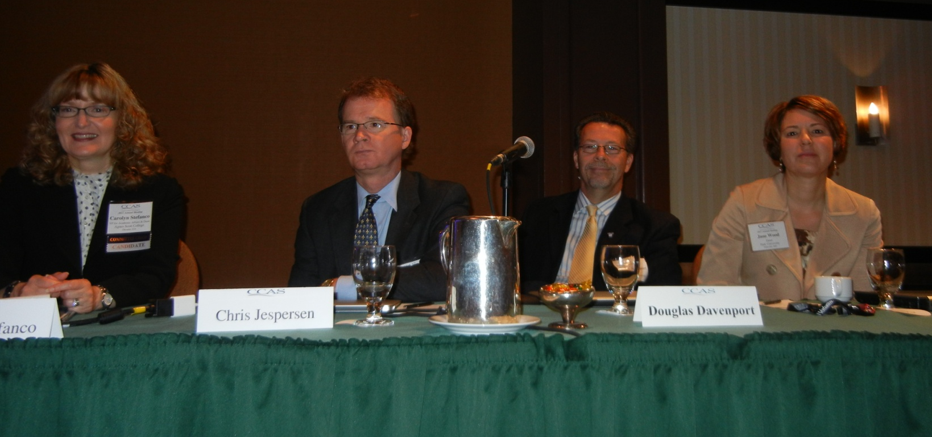
Members of the Committee on Liberal Arts Institutions Carolyn Stefanco (Agnes Scott College), Christopher Jesperson (North Georgia College and State U), Douglas Davenport (Truman State U) and Jane Wood (Park U) sponsored a panel on ““Embracing the World: Internationalizing teaching and learning in the liberal arts.”

Slide 27
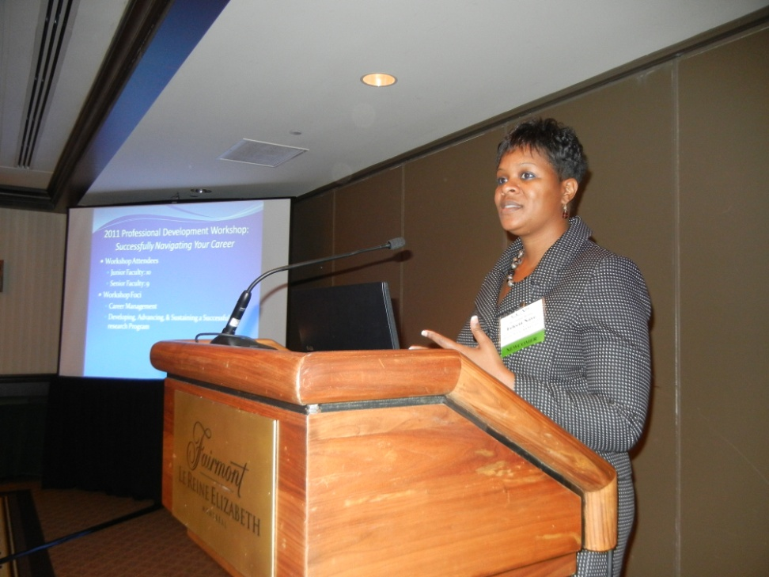
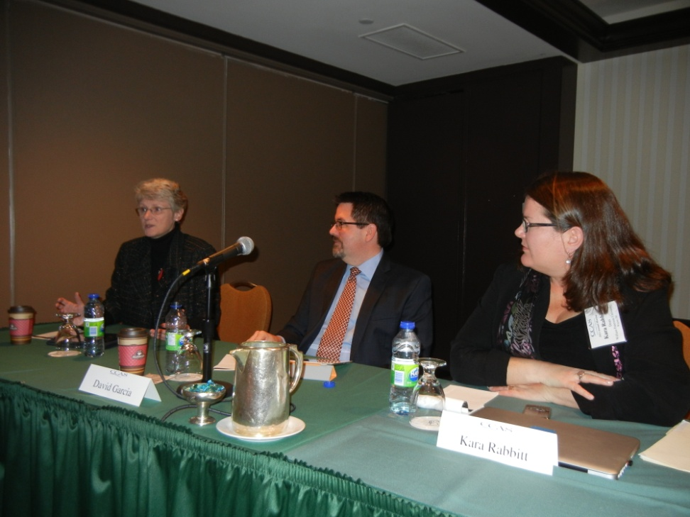
Felecia Nave (Prairie View A&M U) presents on “Cultivating Diverse Faculty Leadership in the STEM Disciplines: Best practices.
Panelists Alison Morrison-Shetlar (Elon U), David Garcia (Ithaca College) and Kara Rabbitt (William Paterson U) coordinated a panel on “Building Better Relationships with Colleges of Education.”

Slide 28
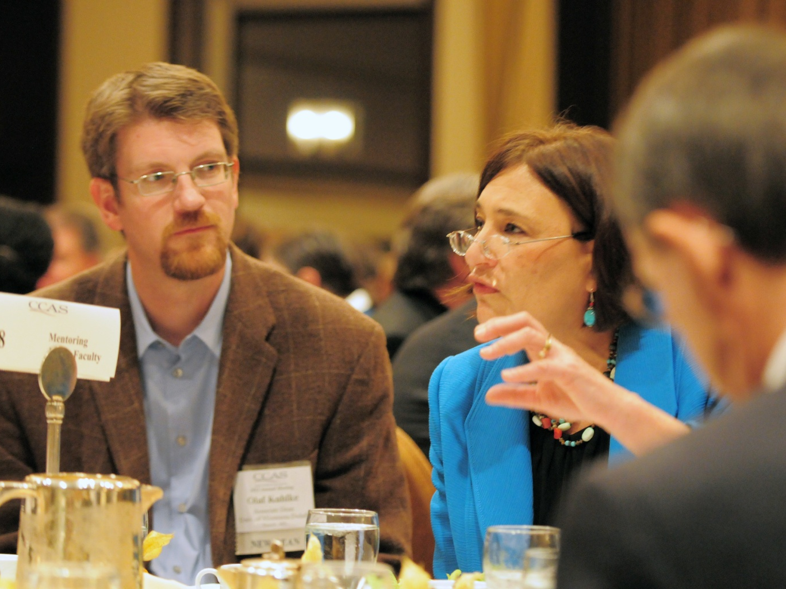
Olaf Kuhlke (U of Minnesota Duluth) and Anne Hiskes (U of Connecticut) discuss “Junior Faculty Mentoring and Community Building” over Thursday’s lunch.

Slide 29
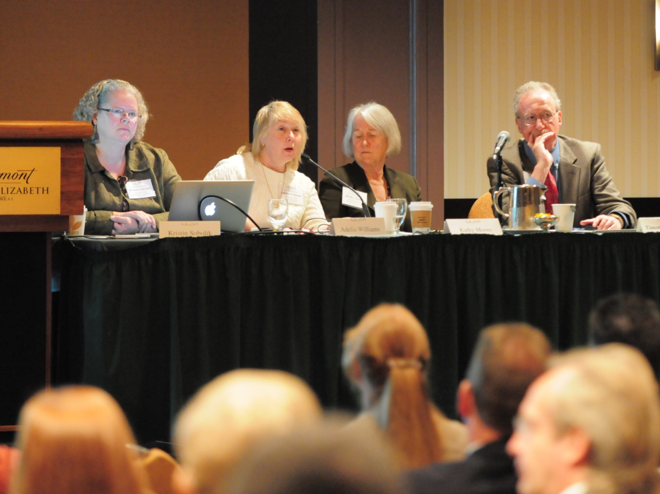
The panel “Fostering Interdisciplinary Curricular and Faculty Development” included presentations by (from left) Kristin Sobolik (U of Maine), Adelia Williams (Pace U), and Kathleen Moore (Oakland U), with Timothy Johnston (U of North Carolina at Greensboro) serving as moderator.

Slide 30
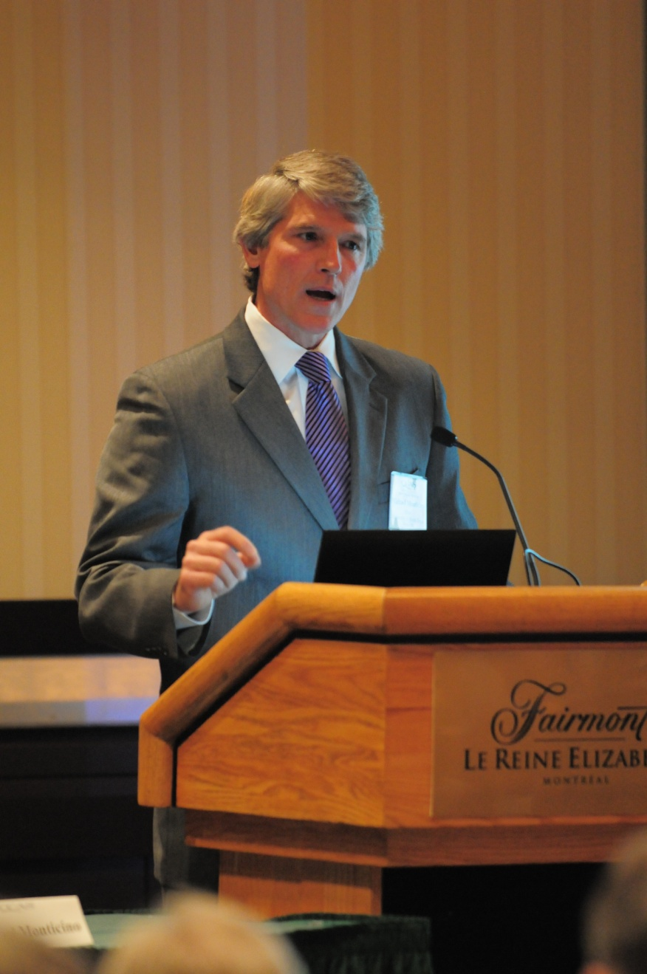
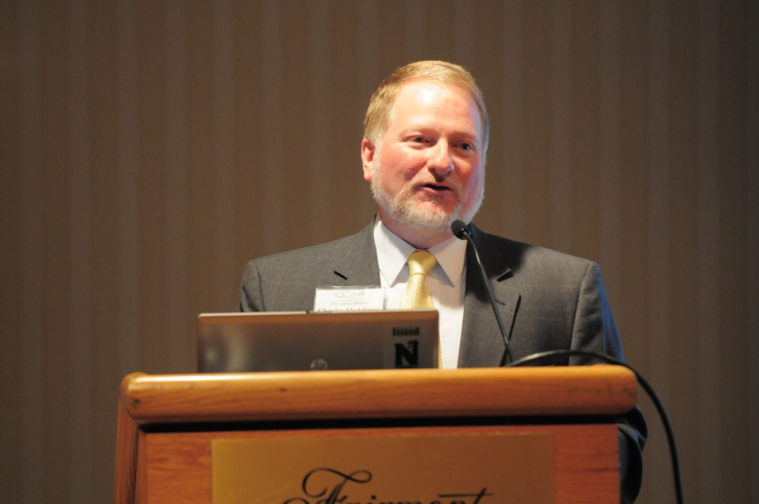
Left: Michael Monticino (U of North Texas) moderated the session “Deans and Departmental Data.
Below: Charles McAdams (Northwest Missouri State U) presented on “Deans and Economic Development.”

Slide 31
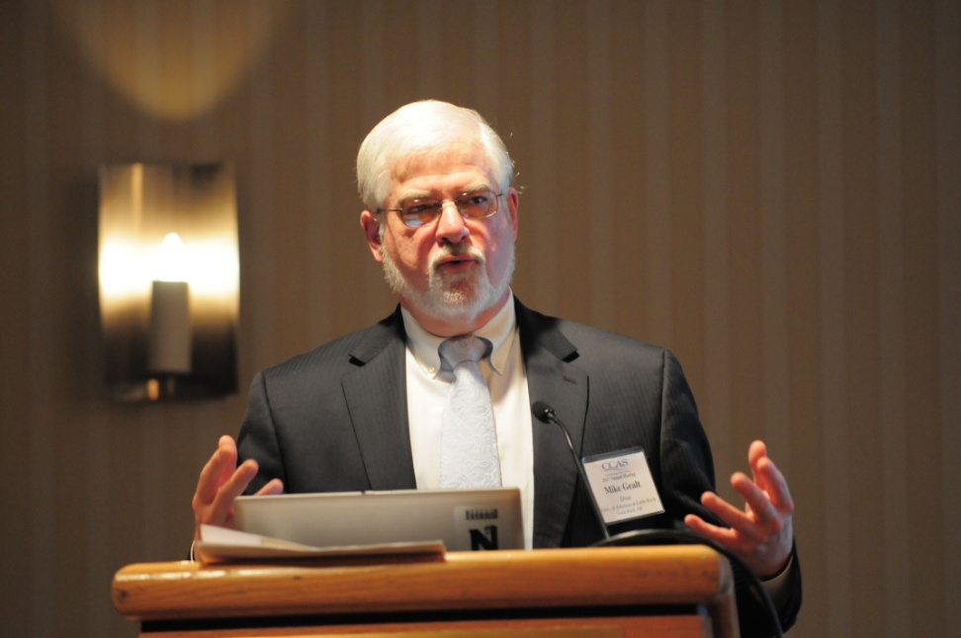
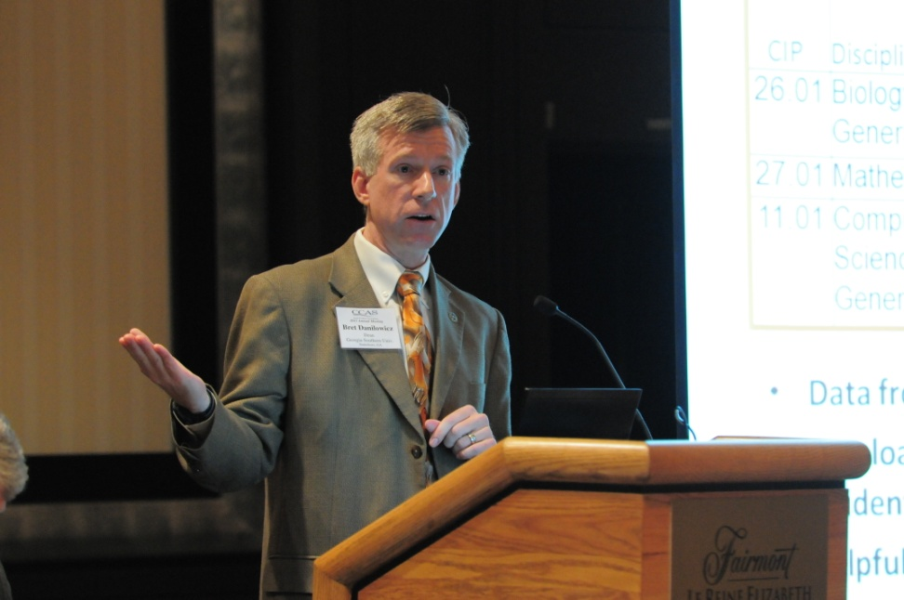
Bret Danilowicz, Georgia Southern U, was a panelist for “Deans and Departmental Data.”
Mike Gealt, U of Arkansas at Little Rock, presented on “Deans and Economic Development.”

Slide 32
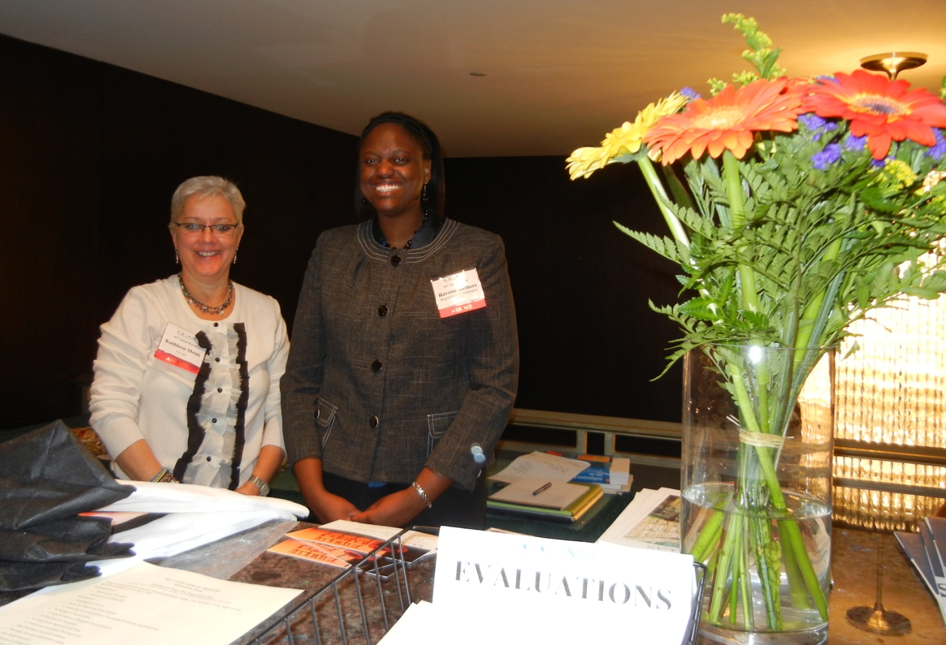
Kathleen Monk and Ravenn Gethers did a masterful job staffing the Registration Desk.

Slide 33

Photo Credits
~International Photography Imaging~
~Anne-Marie McCartan~

