Slide 1

Evaluating Academic Productivity
and Making Data-driven Decisions
in Colleges of Arts and Sciences

Slide 2

Indiana University – Purdue University Fort Wayne (IPFW)
Regional Public Comprehensive
> 14,000 students
Six Colleges and Schools
COAS 63% of Credit Hours
Most Majors
Most Graduates
~ 66% of Scholarly Products

Slide 3
IPFW
Student
Affairs
Academic
Affairs
Financial
Affairs
Health &
Human Services
Visual &
Performing Arts
School of
Education
Arts & Sciences
Dormer School
of Business
Engineering,
Technology & CS
Sciences &
Mathematics
Social Sciences
Humanities
Anthropology
CSD (Audiology)
Political Science
Psychology
Sociology
Biology
Chemistry
Geology
Physics
Mathematics
Communication
English
History
ILCS
Philosophy

Slide 4
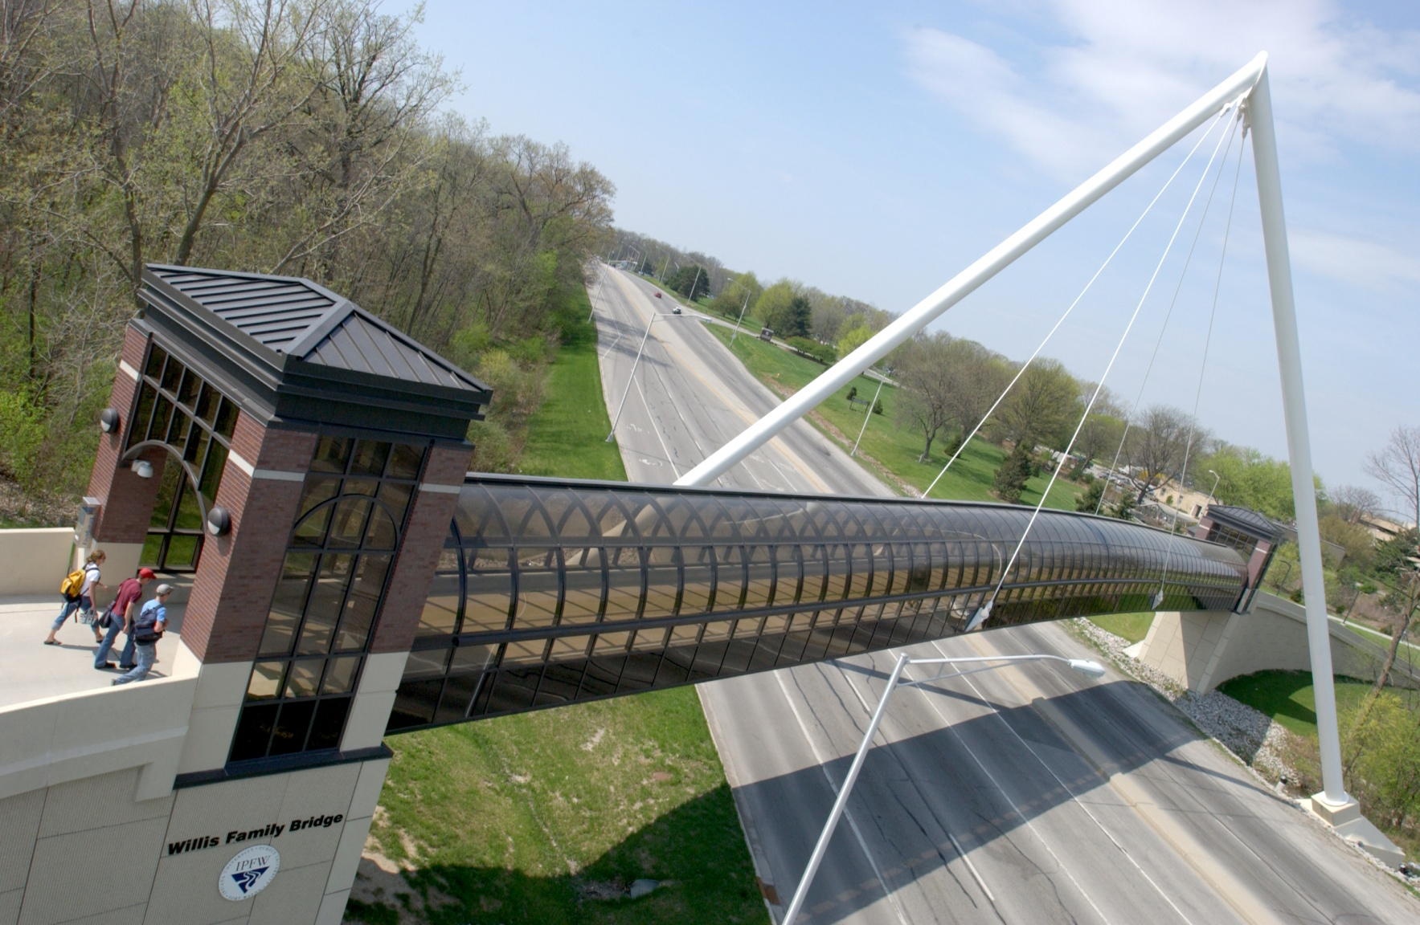
COAS – 15 Departments, Humanities, Social Sciences, Science and Mathematics
Environmental Conditions:
July 1, 2009 Started as Dean
System Mandated Salary Freeze
10% Enrollment Growth
Five New Tenure Track
Lines Added (12 Total)
The Question:
Where to place the lines?

Slide 5

Requests from Departments:
13 Requests from 11 Departments
(Geosciences, Physics,
Poly Sci & History)

Slide 6
Quantitative Analysis: The Criteria
Enrollment (=) Credit Hours
CrHrs/Section
% Enrollment Capacity Filled
% Upper Division Capacity Filled
# of Majors
BA/BS Degrees Conferred
% Faculty FTE Instruction & Research
BA/BS Degrees / FTE

Slide 7
Departmental Rankings Based on Quantitative Analysis

Slide 8

As with all Quantitative Data
GIGO
Major Flaw:
Counting Double Majors

Slide 9
Qualitative Analysis: (High, Moderate, Low)
Tradition/Possibility of External Funding
Graduate Enrollment
Possibility for Regional Partnerships (Engagement)
History of Degrees Granted
Buy in to Assessment/Program Review
Student Success & Retention

Slide 10
Results of Qualitative Analysis of Departments

Slide 11

One Other Essential Factor…
… Curricular Need

Slide 12
Recommendations for New Lines
Biology #3 Quant / #1 Qual
Communication #2 Quant / #2 Qual
Psychology #1 Quant / #3 Qual
CSD* #4 Quant / T#5 Qual
Anthropology #11 Quant* / T#5 Qual
English #5 Quant / T#13 Qual
Mathematics #6 Quant / T#10 Qual
Philosophy #10 Quan / T#7 Qual

Slide 13
VCAA TT Line Allocations
Biology
Communication
Psychology
(CSD)
(Anthropology)
English
(Mathematics)
Philosophy

Slide 14

Lessons Learned
Understand the Data
Invest in your Winners
Be Transparent
Insist on a Face-to-face Meeting
Have the Courage of your Convictions
Q-TIP

Slide 15


