Slide 1
Innovative Practices that Support the Recruitment, Retention, and Advancement of STEM Faculty
Denise A. Battles, David Brakke, Carmen Cid,
David Manderscheid, and Kevin McCaul
Council of Colleges of Arts and Sciences Panel Session
November 12, 2010
Notes:
Title slide – Denise will introduce

Slide 2
Presentation Outline
Introductions and institutional contexts
The case for change
Strategies for recruitment, retention, advancement, and culture change
Wrap-up
Questions and answers
Notes:
Denise will address this slide and describe the overall integrative format we will use in this session.

Slide 3
Introductions and Contexts
Notes:
This slide will introduce the next topic – no additional content is needed

Slide 4
James Madison University David Brakke
18,000 students; ~ 10% graduate
Public; non-urban
College of Science and Mathematics – 145 full-time faculty
Notes:
David B. please add content as appropriate.

Slide 5
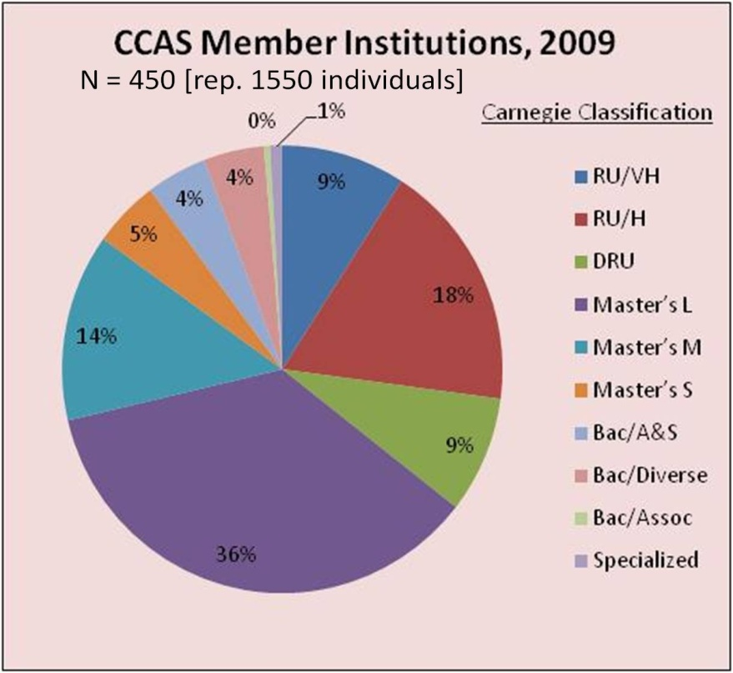
Council of Colleges of Arts and Sciences Carmen Cid, Eastern Connecticut State Univ.
Nearly 500 member institutions and 1,600 deans
Disproportionately high representation among large publics where gender disparities are pronounced
Provides professional develop- ment for deans and chairs
Notes:
Carmen will discuss CCAS’ context

Slide 6
University of Nebraska - Lincoln David Manderscheid
24,600 students in Lincoln, Nebraska
Big 10, AAU, Carnegie Classification, Very High Research
Third year of NSF ADVANCE Institutional Transformation Award, $3.8M, I am a co-PI
26 STEM departments in three colleges: Arts and Sciences, Engineering, and Agriculture
Varying percentages of women by STEM department
Only one female science chair
Notes:
David M. will discuss

Slide 7
North Dakota State University Kevin D. McCaul
14,400 students in Fargo, North Dakota
Research University (high research activity); expenditures > $100M
“Local” population of 200,000; only 6% minority
As North Dakota’s land grant university, emphasis on male-dominated academic programs (Engineering, Agriculture, Science & Mathematics)
In my college (Science and Mathematics), nine departments, 110 tenure-track faculty members, one female full professor!
Advance/Forward NSF grant began fall 2008, so we are in Year 3
Notes:
Kevin will discuss

Slide 8
The Case for Change
Notes:
Denise will comment briefly

Slide 9
The Case for Change
Gender characteristics of science doctorates and faculty
73%
55%
27%
Source: Science & Engineering Indicators 2008
45%
55%
45%
Notes:
Denise will comment briefly

Slide 10
Faculty Recruitment Strategies
Notes:
This slide will introduce the next topic – no additional content is needed

Slide 11
University of Nebraska - Lincoln
Dual-Career Program
The need
The development
How it works
Outcomes
Notes:
David M. will discuss

Slide 12
James Madison University
Active and flexible hiring
Good colleagues and welcoming atmosphere
Facilities
Summer support
Dual-career possibilities
Strategic partnerships – SRI International
Professional development – Center for Faculty Innovation
Notes:
David B. please add content as appropriate.

Slide 13
Faculty Retention Strategies
Notes:
This slide will introduce the next topic – no additional content is needed

Slide 14
North Dakota State University Junior Faculty Mentoring Cohorts Program*
Same gender mentoring groups
Comprised of 2 tenured faculty (co-chairs) and 2-3 new faculty
Meet ~ monthly from first year through 3rd-year review process
Planned activities offered once/semester (e.g., “scholarly writing; teaching assessment”)
Most frequently discussed topics
teaching effectiveness
starting a research program
PTE process
Work-family life issues
Informal rules of the institution
Networking within the department
*(program developed by Wendy Reed, Biological Sciences & Donald Schwert, Center for Science and Math Education)
Notes:
Kevin will discuss.

Slide 15
James Madison University
Center for Faculty Innovation
Mentoring
Developing leadership
Empowering faculty
Research and travel support
Active and engaging seminars
Notes:
David B. please add content as appropriate.

Slide 16
Advancement Strategies
Notes:
This slide will introduce the next topic – no additional content is needed

Slide 17
North Dakota State University Emerging Leadership Program
Within College of Science & Mathematics
Identified 14 “potential leaders” (advanced assistant and associate professors)
Target both department leadership but also university committee leadership (e.g., program review)
Monthly or twice-monthly group sessions
Sample Topics
Why be a leader? And why not? (panel session)
Dep’t organization/structure (forming committees, setting agendas, assigning teaching—chair panels)
Conflict management (case studies)
University structure (dealing with administrators and who are they, anyway?)
Budgets: department, college, university levels (panel)
Notes:
Kevin will discuss

Slide 18
University of Nebraska - Lincoln
Associate Professor Program
The need
The development
How it works
Outcomes?
Notes:
David M. will discuss

Slide 19
Strategies for Culture Change
Notes:
This slide will introduce the next topic – no additional content is needed

Slide 20
University of Nebraska - Lincoln
Most people want diversity
Especially when money is involved
Leadership
Peer pressure
Insight from below
Data
Notes:
David M. will discuss

Slide 21
Council of Colleges of Arts and Sciences
Organizational change as a means of facilitating institutional change in member institutions
Target audience = mid-level academic leaders (chairs, deans)
NSF ADVANCE grant secured to promote
leadership development that considers gender equity
acquisition of new knowledge and skills for enhancing recruitment /retention of diverse faculty
Notes:
Carmen will discuss

Slide 22
Goals of the CCAS ADVANCE Initiative
Infuse gender equity content and activities into CCAS's PD programs in a sustainable way.
Maximize opportunities for positive impacts of the CCAS ADVANCE Initiative on individuals underrepresented in STEM disciplines.
Develop, utilize, and make widely available a set of robust case studies that incorporate gender equity elements.

Slide 23
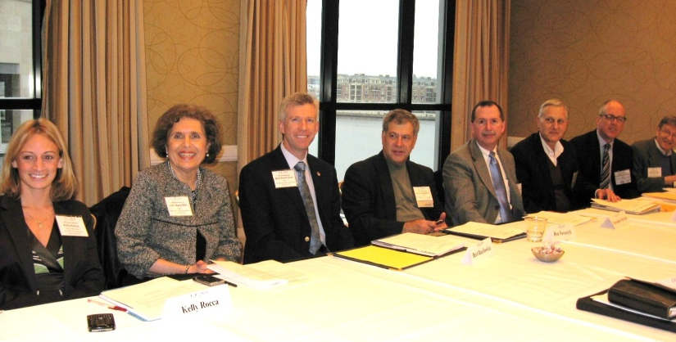
Progress to Date
Developed internal and external overseeing infrastructure with diverse representation
Developed 5 case studies and 3 guides
Infused gender equity content into CCAS seminars for new Deans and for Dept. Chairs – July 2010, October 2010, with outreach to MSI’s
Panel, poster and workshop presentations at 2009 and 2010 CCAS annual meetings
Created web pages and began collecting resources to inform CCAS members
2009 CCAS case study session

Slide 24
Challenges and Future Plans
Increasing awareness of how perspectives affect decision-making, policy-making to audiences with varied GE understanding
Seamless integration of GE content within CCAS existing programs, and facilitator training
Increasing interactive GE discussion resources
Recruitment of GE-focused facilitators for CCAS professional development programs
Development of more GE-related case studies, reflecting CCAS member needs

Slide 25
Wrap-up
Notes:
Denise will making some concluding observations/remarks

Slide 26
Acknowledgements for the CCAS ADVANCE grant
This material is based upon work supported by the National Science Foundation under Grant No. 0930138. Any opinions, findings, and conclusions or recommendations expressed in this material are those of the author(s) and do not necessarily reflect the views of the National Science Foundation.
Notes:
Denise will provide NSF acknowledgment

Slide 27
Q - and - A
Notes:
Denise will facilitate the Q-and-A with the audience

