Slide 1
Metro/Urban Institutions: It’s About Belonging — Strategies for Student and Faculty Success in the Urban/Metro Commuter Institution through Community BuildinG
Elaine Carey, Purdue University Northwest
Troi Carleton, San Francisco State University
Chris Chulos, Roosevelt University
Kim Martin, University of New Orleans

Slide 2
Belonging: In and Of the Community
Elaine Carey
Dean, College of Humanities, Education, and Social Sciences
Purdue University Northwest
@lenicarey and elaine.carey@pnw.edu

Slide 3
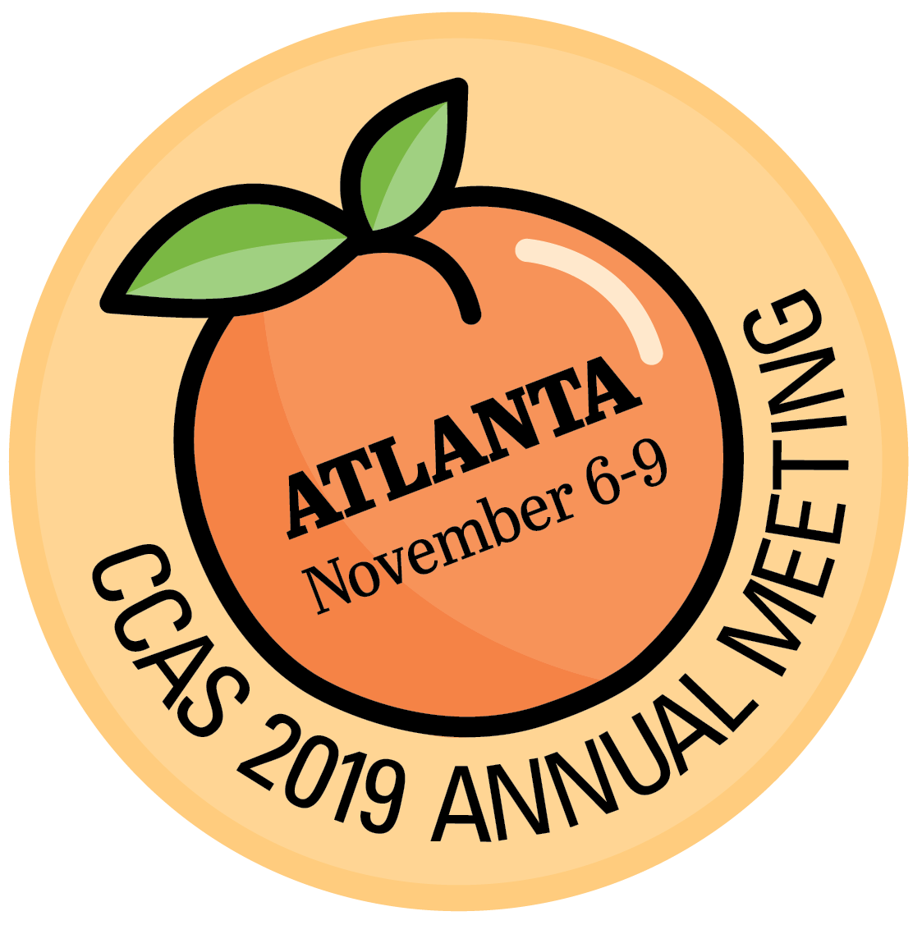
Community Engagement and Student Belonging
As a new dean, how does one engage the community
to partner with students and the college?
Examples:
1. Student Advisory Board
2. Alumni Advisory Board
3. Career Center
4. Local Foundations
5. Giving Back: Professional Clothing Locker

Slide 4
Student and Alumni Boards

Slide 5
Career Center: Focus Group with Potential Employers

Slide 6
Local Foundation: On the Table

Slide 7
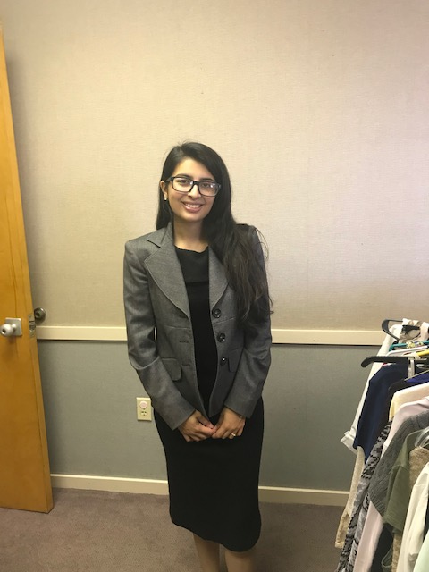
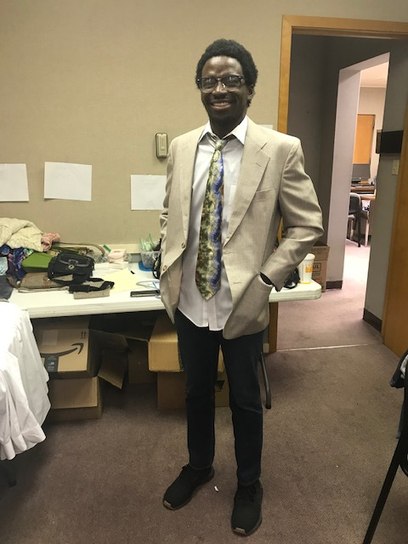
Evidence and Result

Slide 8
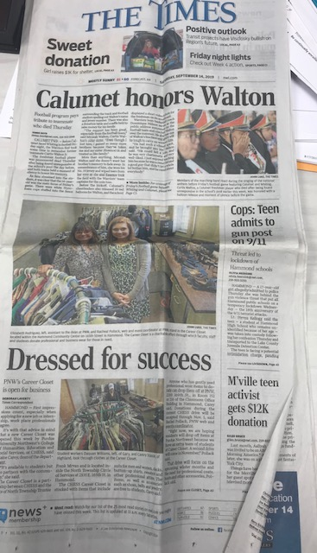
Marketing and Communication

Slide 9
Belonging: The Campus as our own
Chris Chulos
Associate Dean, College of Arts and Sciences, Roosevelt University
@cchulos and cchulos@Roosevelt.edu

Slide 10
Roosevelt University
Today
25% African American
19% Latinx
50% first-gen/low income
22% residential
1945
Diversity and Inclusion (Jews and Blacks)
Social Justice

Slide 11
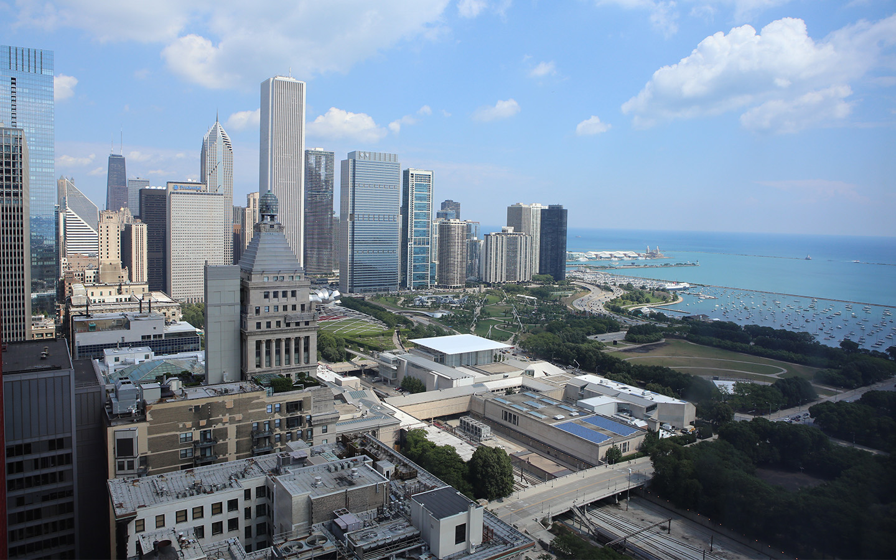
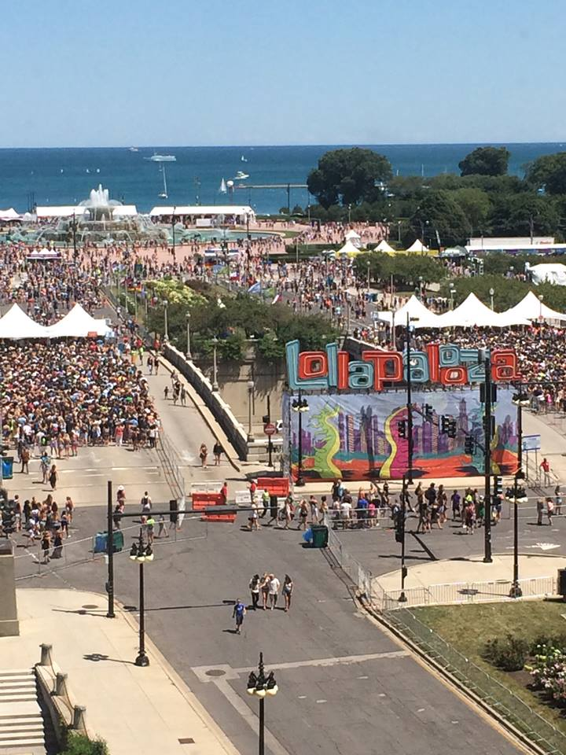
#ChicagoIsOurCampus
University and campus are for you
Campus as our space
City as campus
Diversity and inclusion

Slide 12
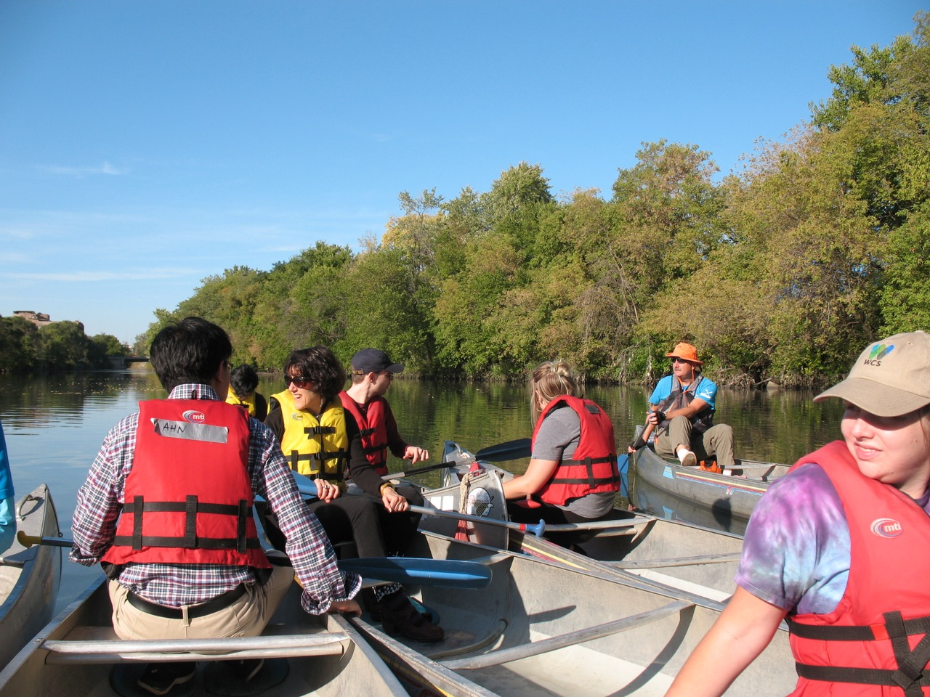
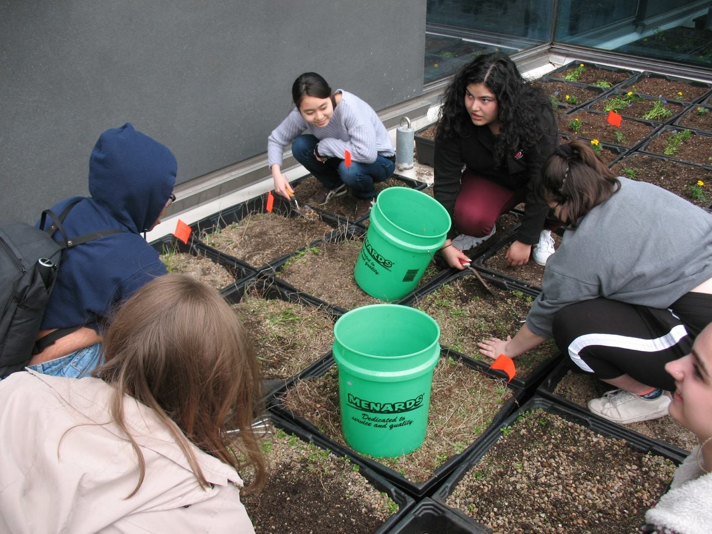
Sustainable Community
Building community in class
Applying knowledge through EXL
Community building and alumni
https://rusustain.wordpress.com/

Slide 13
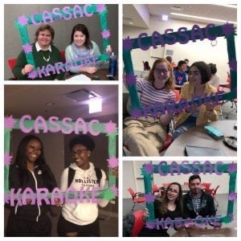
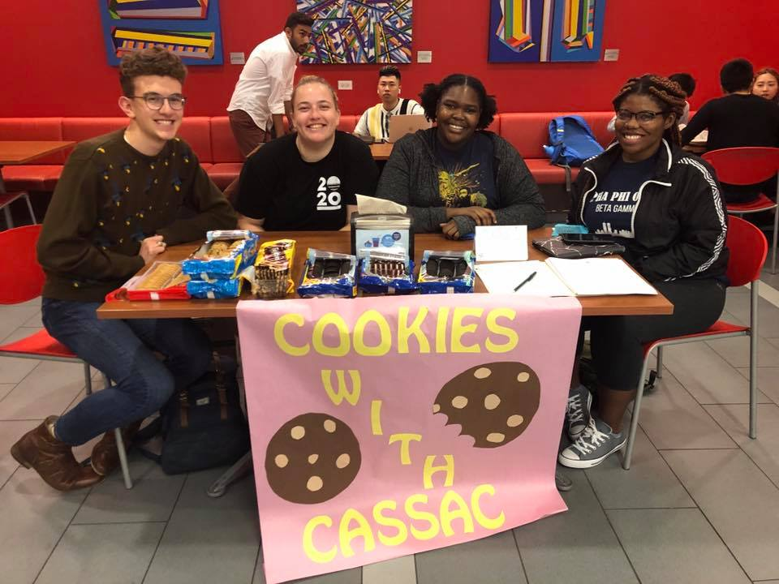
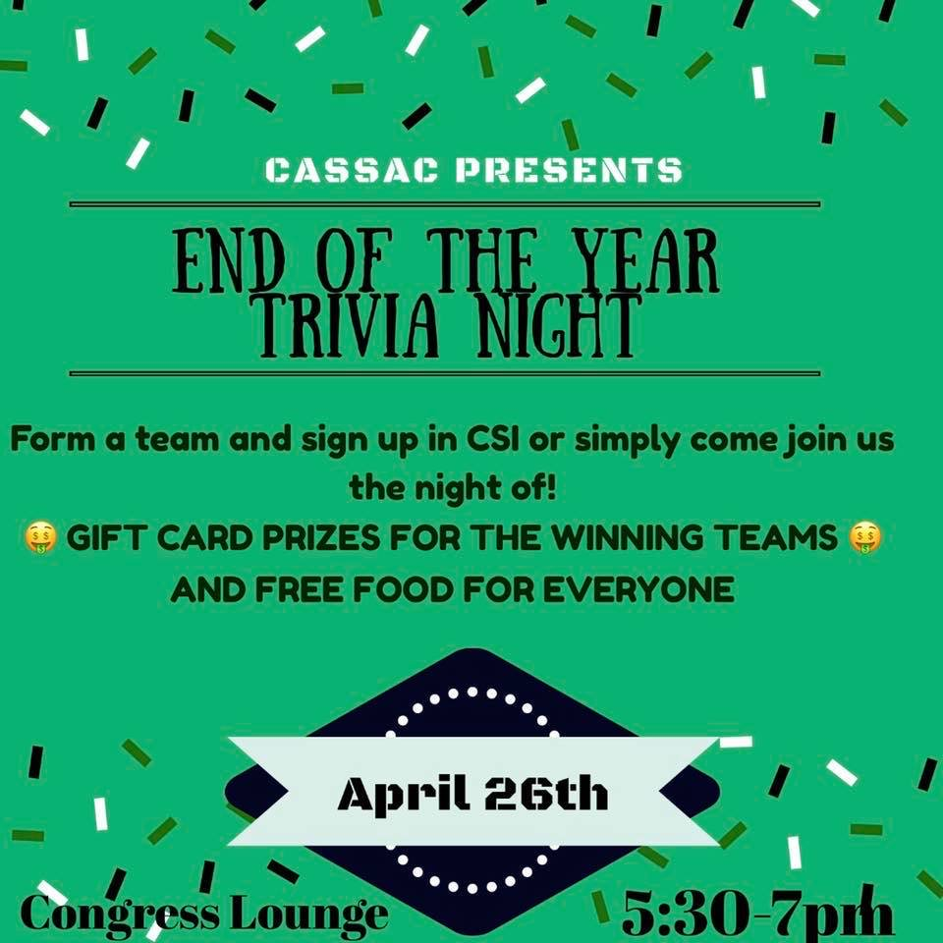
Campus as Our Space
CAS Student Advisory Council
Bringing together all majors
Community of commuting and residential students
https://blogs.roosevelt.edu/cassac/

Slide 14
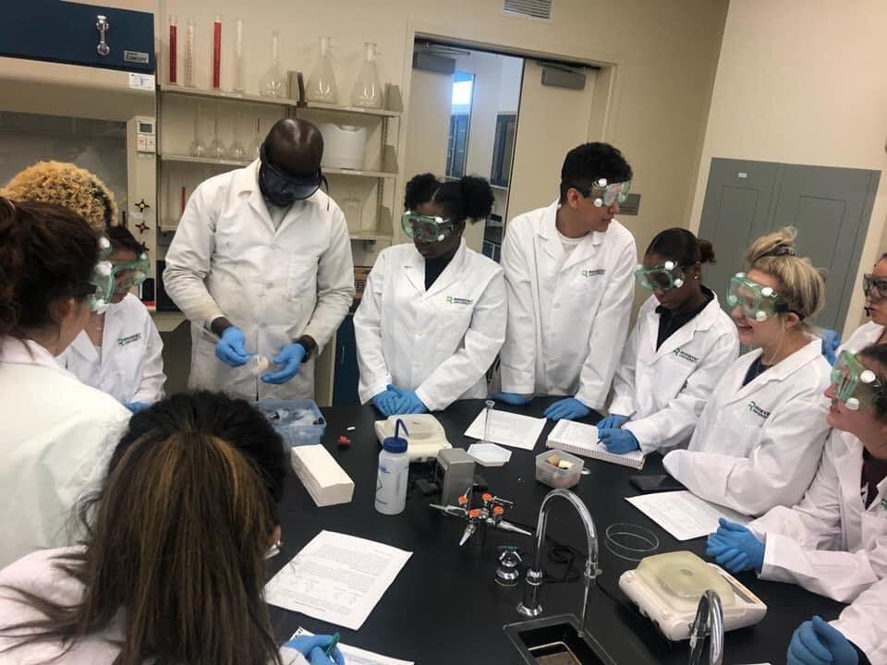
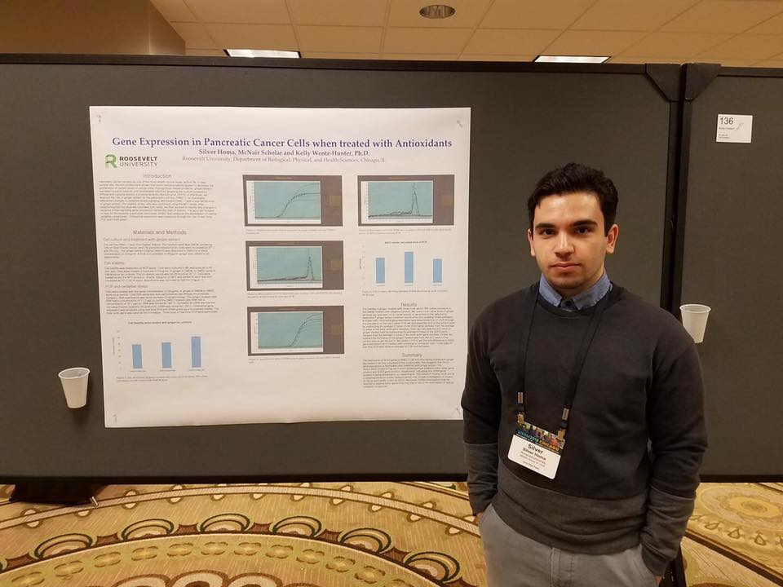
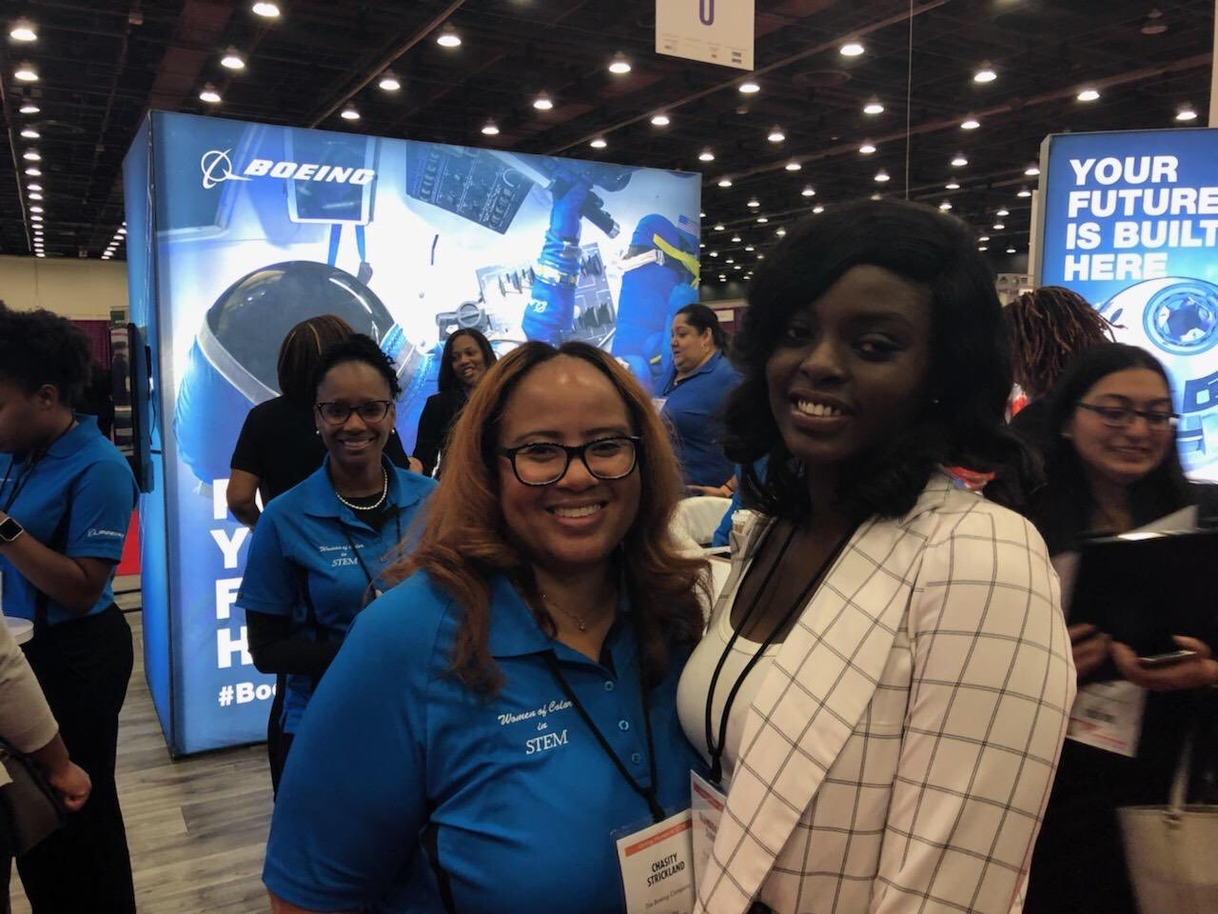
A Sense of Belonging
Howard Hughes Medical Institute
McNair Scholars
First gen, under-represented, low income
https://blogs.roosevelt.edu/casgrad/
Notes:
Silver Homa, Roosevelt University biology student, McNair Scholar and research assistant for Prof. Wentz-Hunter, recently presented his research on pancreatic cancer at the Society for Redox Biology and Medicine meeting in Chicago.

Slide 15
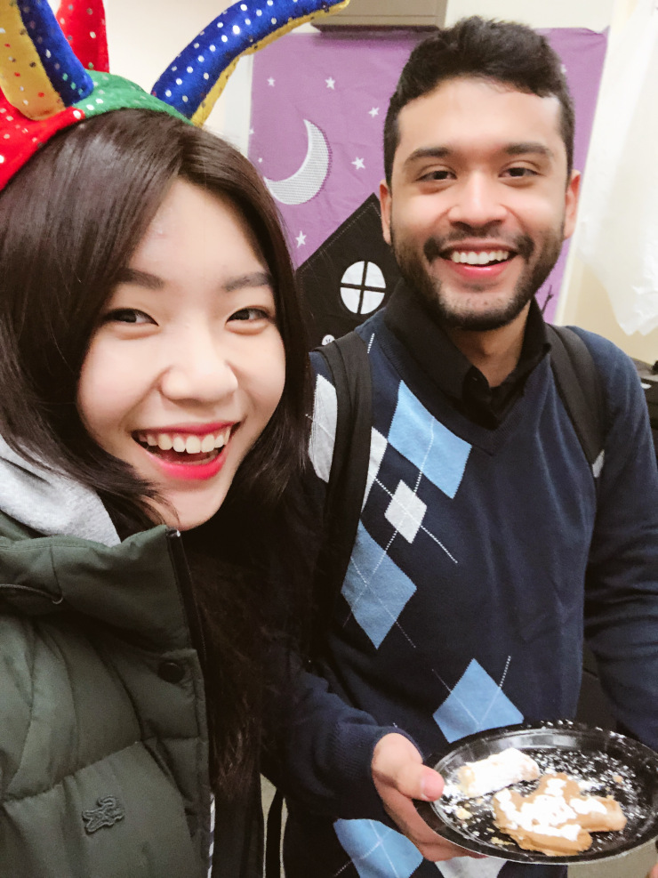
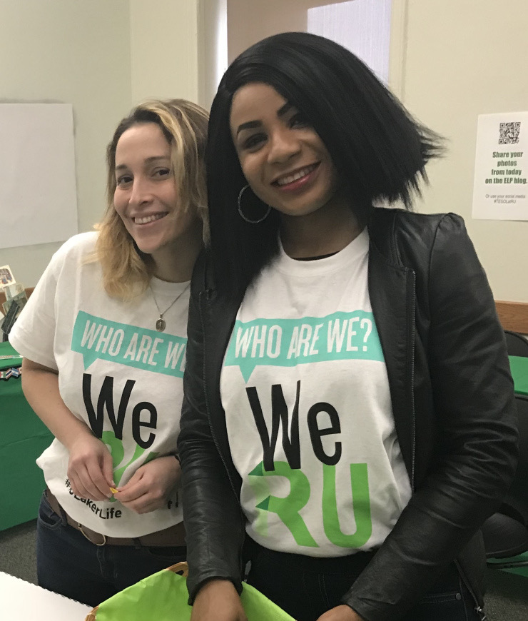
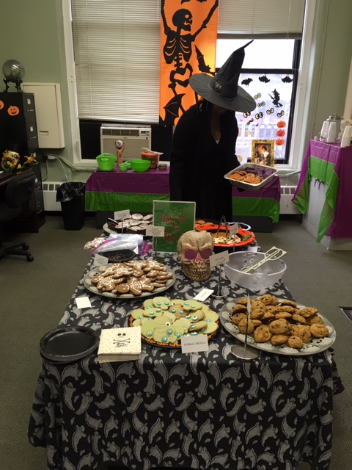
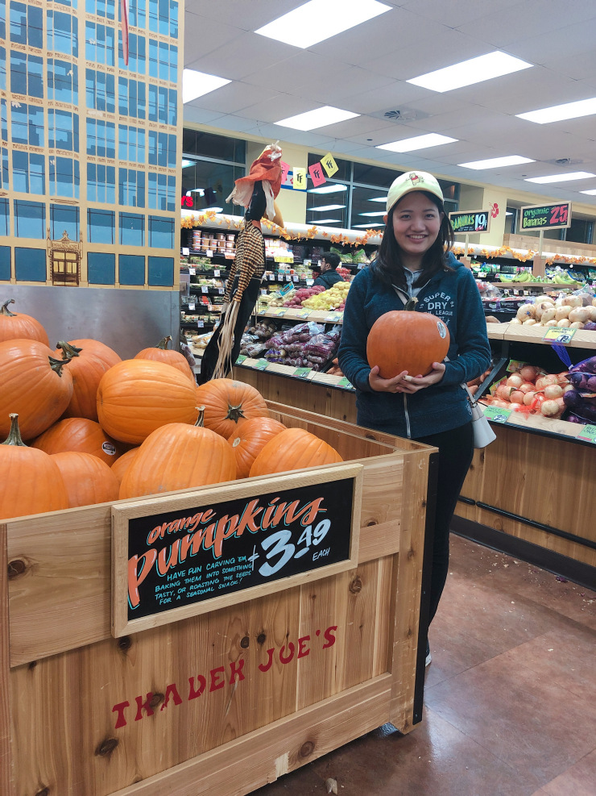
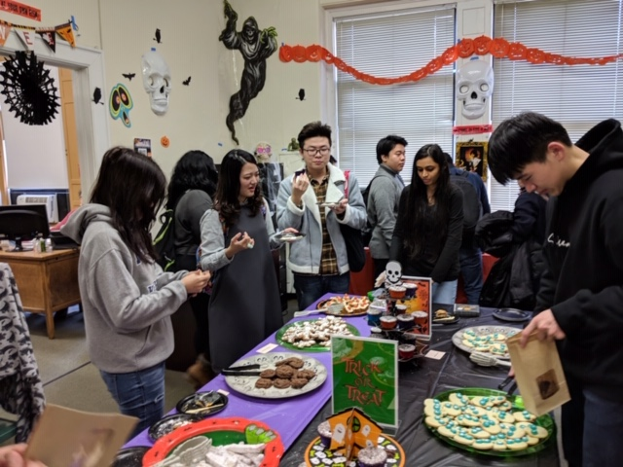
Everyone is Welcome

Slide 16
Building community despite the commute…
Troi Carleton, Associate Dean, College of Liberal & Creative Arts
San Francisco State University
troi@sfsu.edu

Slide 17
San Francisco State University
23,000 students at San Francisco State University
9,000 majors in the College of Liberal & Creative Arts
575 faculty (both T/TT and adjunct)
99 staff members
Largely a commuter college

Slide 18
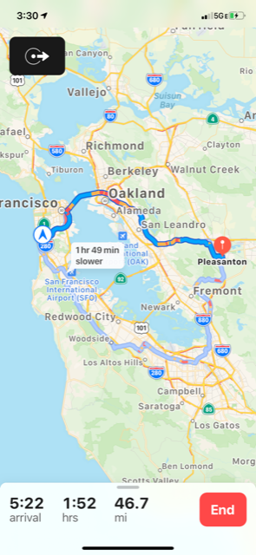
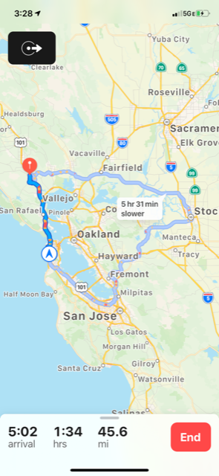
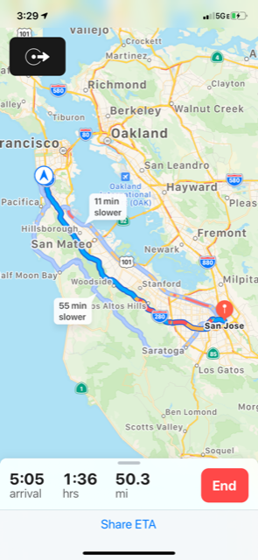
Daily Drudge...Monumental Challenge
How can we create a sense of community and belonging when we spend hours a day commuting?
3:30 p.m. on a random Thursday afternoon

Slide 19
What are faculty telling us they need?
to feel supported
to have opportunities to connect
to feel appreciated
to feel recognized
Key Components: Belongingness and Community

Slide 20
Four Things We Did
Formed a college Professional Development Committee
(Programming Budget: 26K)
Appreciation: Bookended the year with 2 community-building events
Opening College Meeting and Mini-Retreat
End-of-the-Year Faculty Showcase and Banquet
2) Opportunity: Interdisciplinary collaboration/relationship building through a college Affinity Group program
3) Support: Seed money for innovative projects—Extraordinary Ideas Grants
4) Recognition: College Faculty and Staff Excellence Awards

Slide 21
Opportunity-Appreciation-Recognition
Opening College Meeting—Not Business as Usual
Printed nametags—Departments, no rank
45 minutes of social time with coffee and pastries as part of the agenda
Slideshow of faculty accomplishments/activities from the previous year
Showcase college talent
Presentation of Peer-Nominated College Excellence Awards:
Faculty: Teaching; Scholarship and Creative Activity; Service
Staff Excellence Awards

Slide 22
Opportunity-Appreciation
Mini-Retreat—Faculty-Led Affinity Groups
Faculty feeling isolated/desire to interact with colleagues across disciplines.
Faculty-Led Affinity Groups with Lunch
Open-ended interdisciplinary collaboration
2 sponsors, each from different departments
1st year—89 faculty members engaged in 8 affinity groups
2nd year—150 faculty members engaged in 11 affinity groups

Slide 23
Support—Opportunity
Extraordinary Ideas Grants Program
Up to $3,000 in seed money for interdisciplinary collaborative ideas
Open to Affinity Groups and to other faculty in the college
Criteria—must reach across disciplines and have at least 2 faculty sponsors from different departments
1st year—10 proposals
2nd year—18 proposals
Objective: encourage collaboration and support community

Slide 24
Opportunity—Appreciation—Recognition
End-of-the-Year Faculty Showcase and Banquet
Faculty showcase their scholarship, research, and creative work
Short program highlighting 6 faculty members from different disciplines/ranks
Buffet dinner with plenty of time to socialize
“This is the first time I’ve been to a work event where I wasn’t expected to do something.”
“I’ve been here 20 years and never has there been an event like this?
Can we do it next year?”
“It’s so wonderful to just have time to just connect with my colleagues!”
“What a great way to end the year!”

Slide 25
Strategies for Success Despite the Commute
Take advantage of when faculty are already on campus
Make sure your programming is worth the commute
Promote widely/enthusiastically; plan well/attend to details; provide food
Keep it faculty-driven—Listen to what they are asking for
Never miss an opportunity to praise and recognize your faculty and staff
Create opportunities/space for community to flourish and relationships to grow

Slide 26
Thank you

